Slide 1


Design Thinking
ML Bootcamp edition

Slide 2

Haveeeee you met me?
In the group, introduce yourself, where you’re from, what you do and 1 fun fact.
Notes:
5 mins

Slide 3
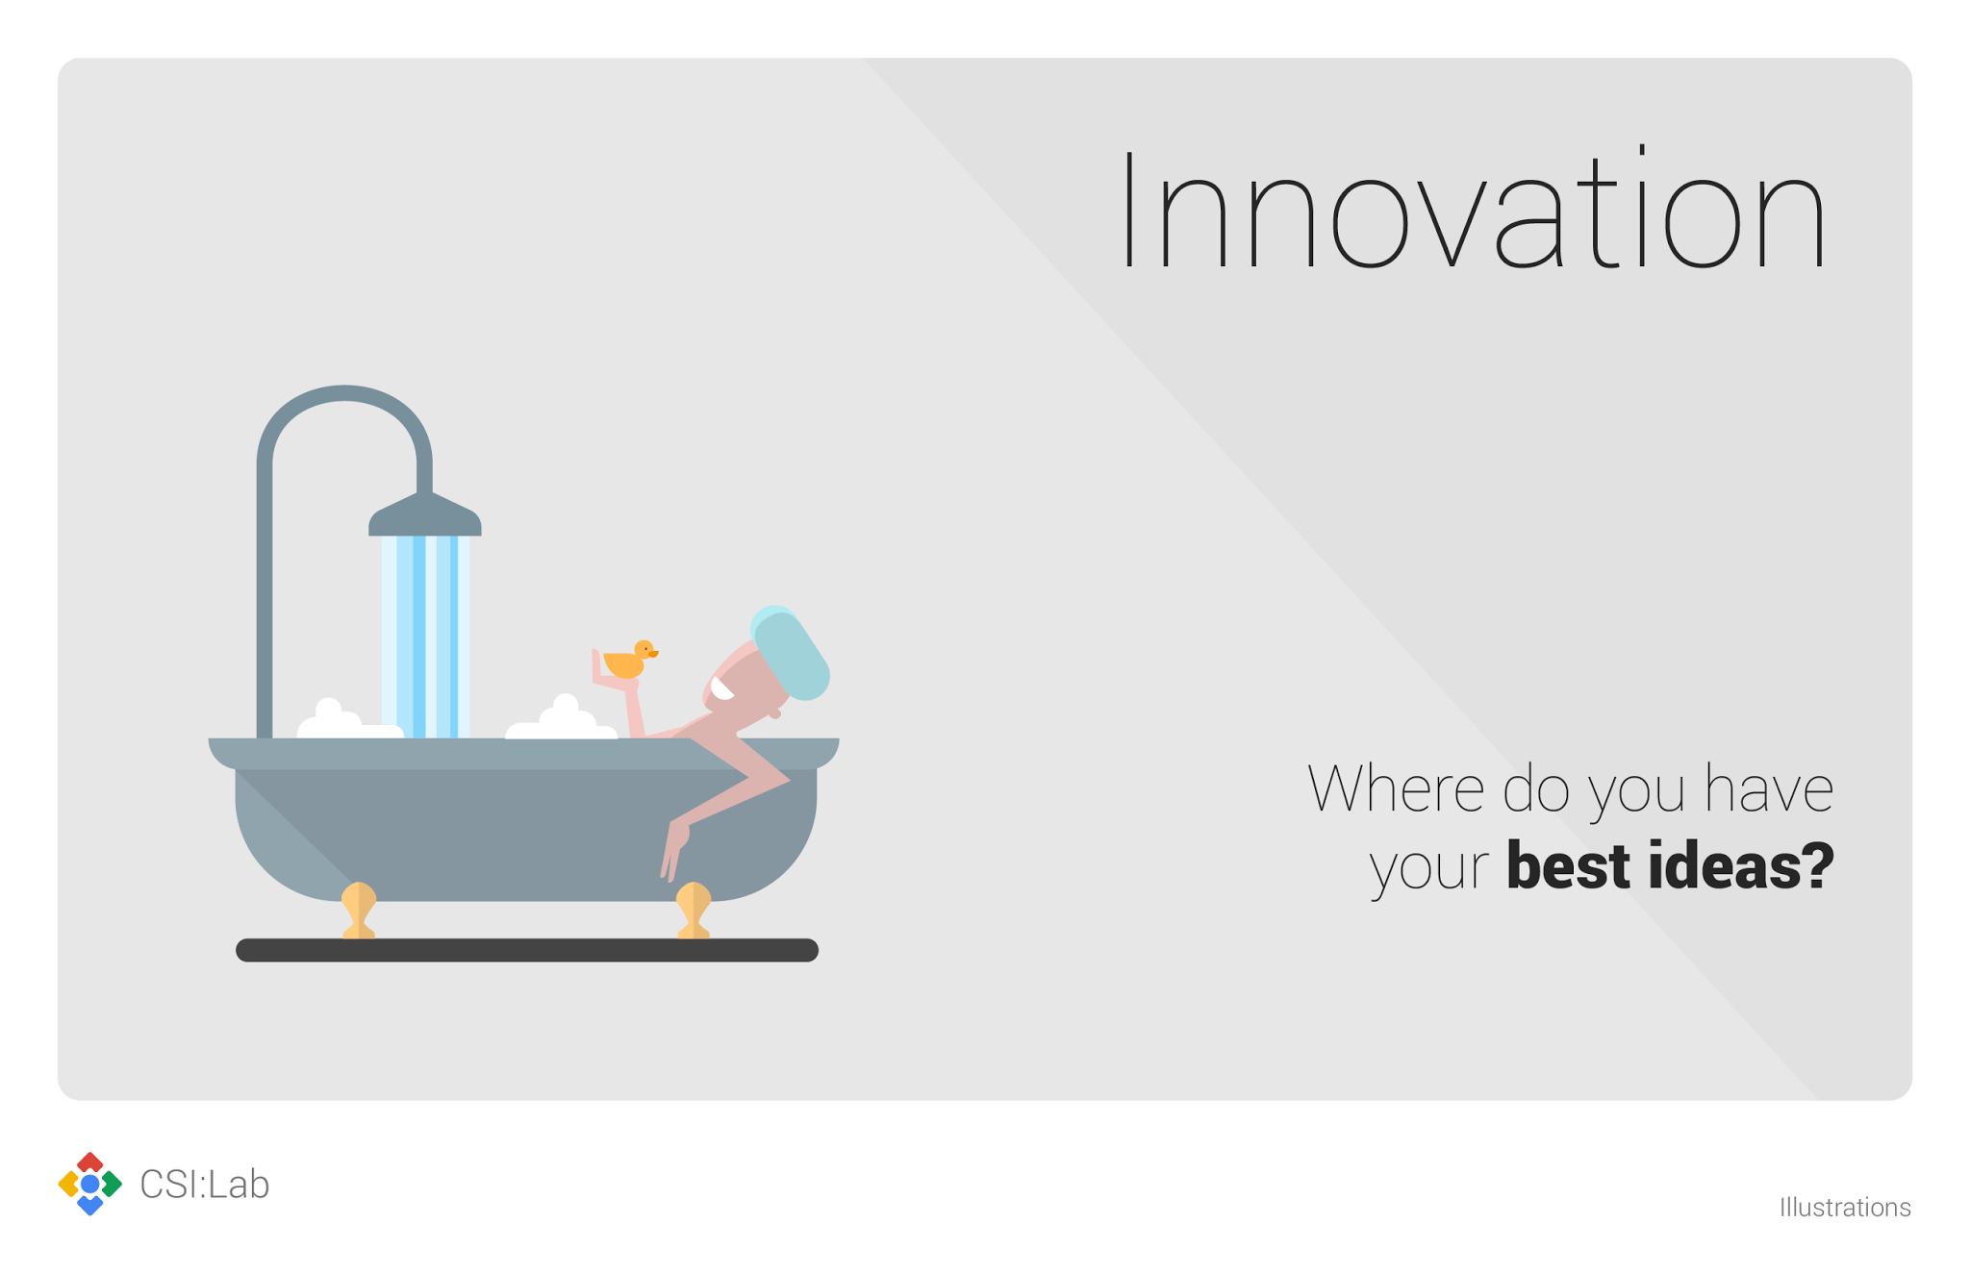
Lesson 1:
Prototyping matters (more on that later)
Lesson 2:
We need to identify the assumptions in our project – the real customer needs, the cost of the project, the duration of the service, etc. – and test them early and often!
Notes:
Ask participants:
Where or when are you most innovative? Where do you get your best ideas?
IMPORTANT: ASK PARTICIPANTS to share their answers and YOU (as the facilitator) log their answers at go/yourbestideas (fill out the form as they shout out the answers).

Slide 4

Innovation
It’s not an event.
It’s a mindset.
Prototyping game

Slide 5

Focus on the user
Think 10X
Divergence
Divergence
Convergence
Convergence
Divergence
Convergence
Divergence
Convergence
Be prototype driven
(Don’t be afraid to fail :))
Notes:
[ 15 mins mark ]

Slide 6

Focus on the user
Think 10X
empathy
definition
brainstorm
prototype
test
Be prototype driven

Slide 7
What is your Challenge?
E.g. Find ways to detect fraudulent activities using ML.
Notes:
Think about 1 challenge and write it on sticky note that you wish to solve the most in the next 5 mins.
Once you’re done, stick it up on the flipchart.

Slide 8
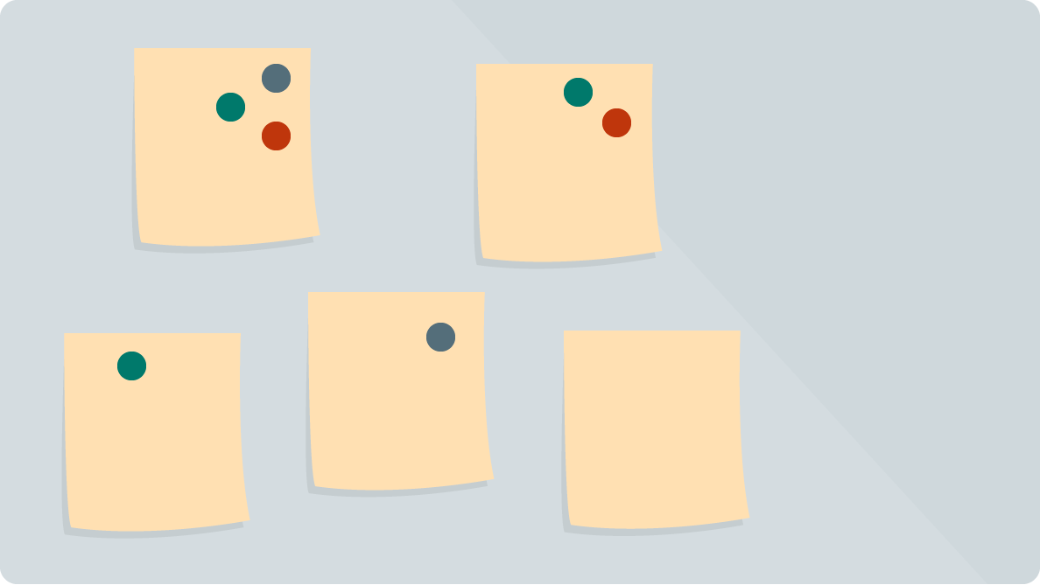
Pitch & Vote
Notes:
Each person will have 3 votes. Use pen / marker to indicate your vote. 10 mins.

Slide 9
Your Challenge:
Write the most voted challenge on the flip chart.
Notes:
[ 30 mins mark ]

Slide 10

Focus on the user

Slide 11

Focus on the User
“There is no substitute for personally watching and listening to real people”
- Larry Page

Slide 12

Focus on the User
and all else follows.

Slide 13
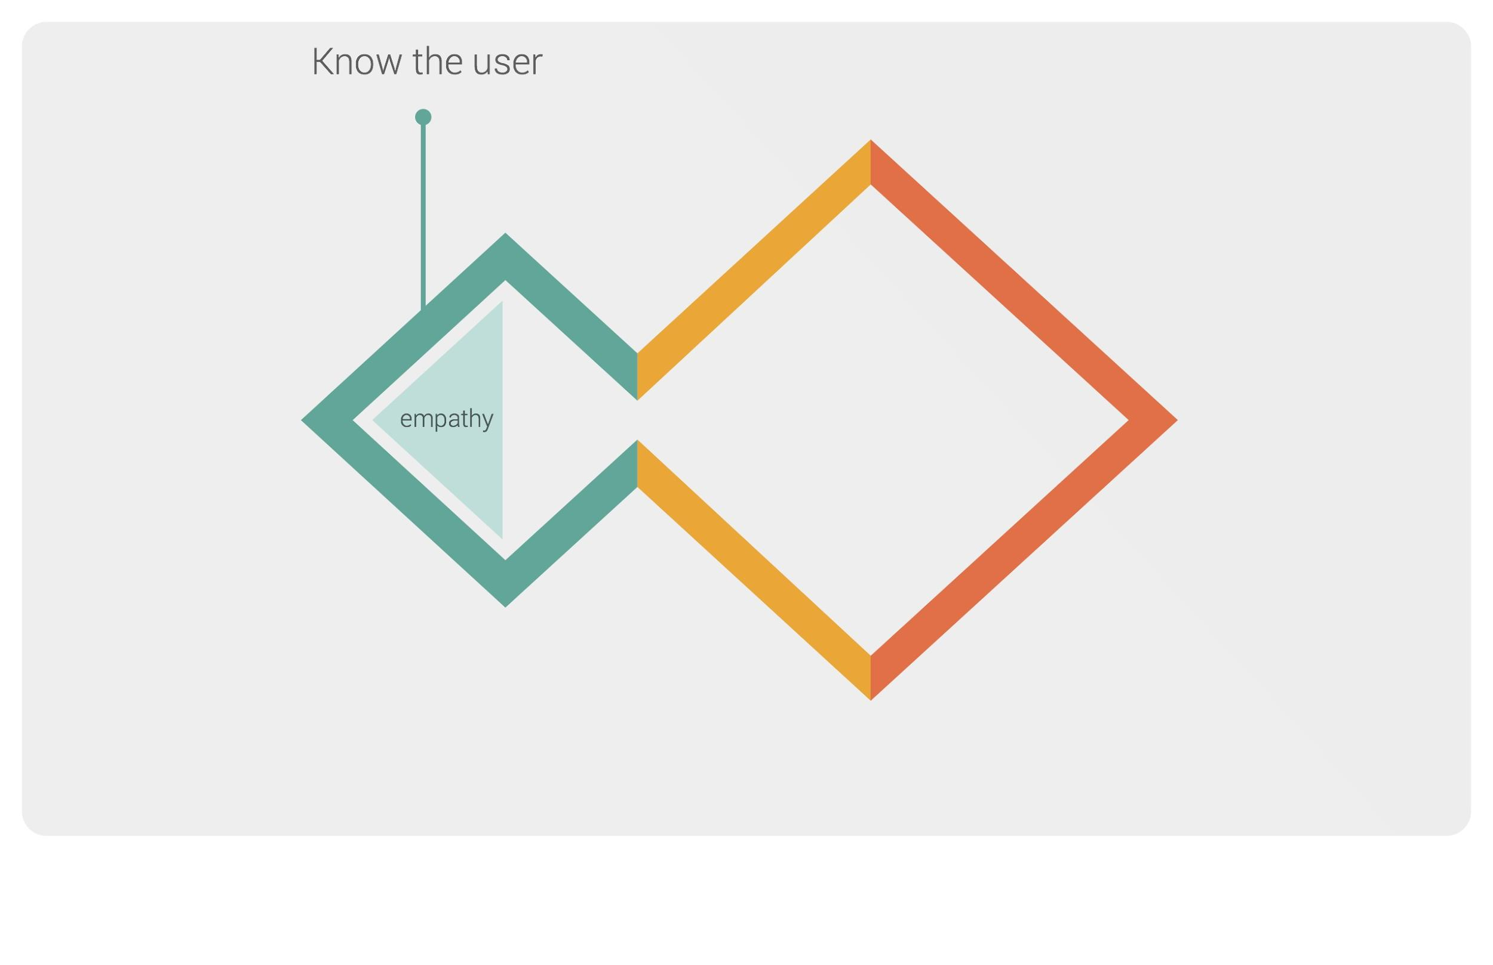

Focus on the user
Empathy

Slide 14
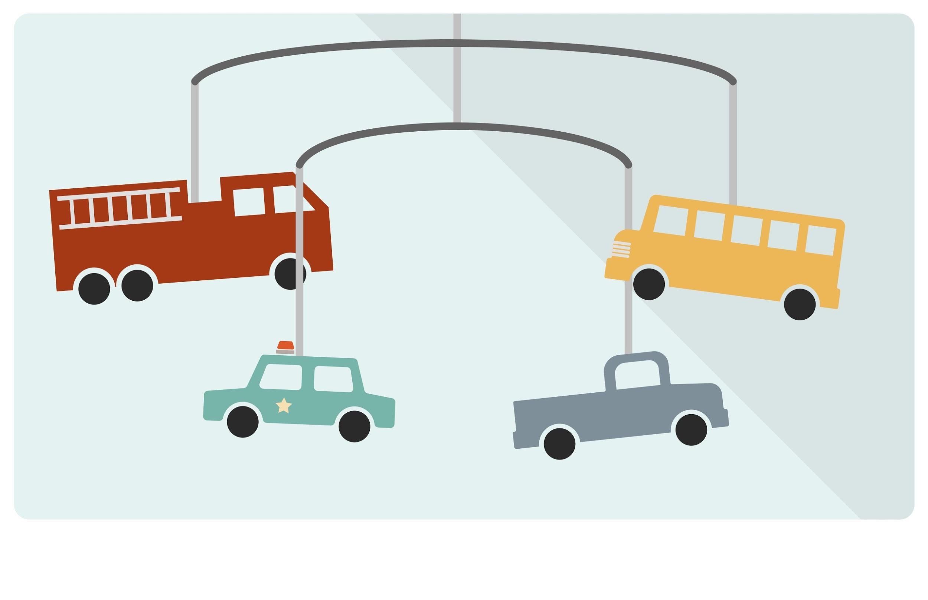

Slide 15
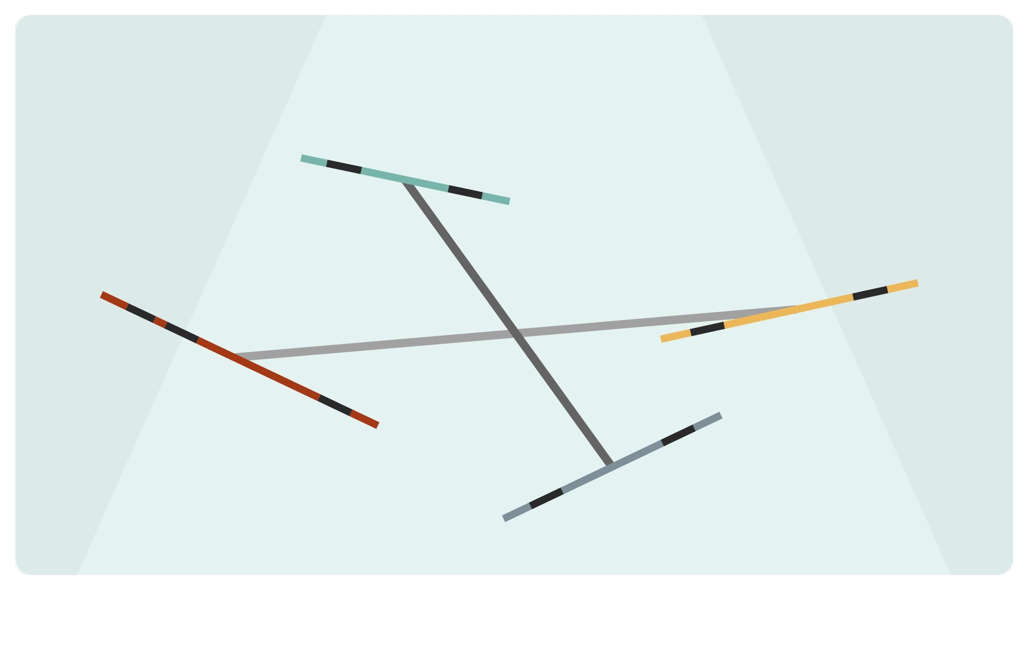

Slide 16

Shifting your perspective is better than being smart
- Astro Teller, Google[x]

Slide 17

Inspiration
Notes:
DOUG DIETZ - PRINCIPAL DESIGNER, GE HEALTHCARE
Doug had been designing MRI and CT machines for more than 20 years at GE when he came to the d.school’s executive education program. He returned home and immediately decided to dig into the user experience of the cutting-edge technology he designed. Beyond how it looked and functioned, how was the experience for patients? Immediately he found an extreme need: Children–frequently terrified by the idea of lying still and alone in the midst of huge, noisy equipment–often needed to be sedated to get through a scan, adding unnecessary risk, fear and creating a generally awful experience. Without an official budget or staff, Doug put together a team of people who cared deeply about the issue — staff from a local children’s museum, kids, doctors and hospital workers whose job it is to help families get through a scan.
The result? With some paint, scents, lights and a little imagination, the scan rooms were turned into adventures: in one room, the room is an ocean and the scanner is a submarine, in another the scanner becomes a tent in a camping experience. The “adventure series” scanners have been hugely popular with kids, and the hospitals and doctors who are GE’s customers. Doug now trains other GE employees–both in the medical division and beyond–to use design thinking and innovation methods in their teams.

Slide 18
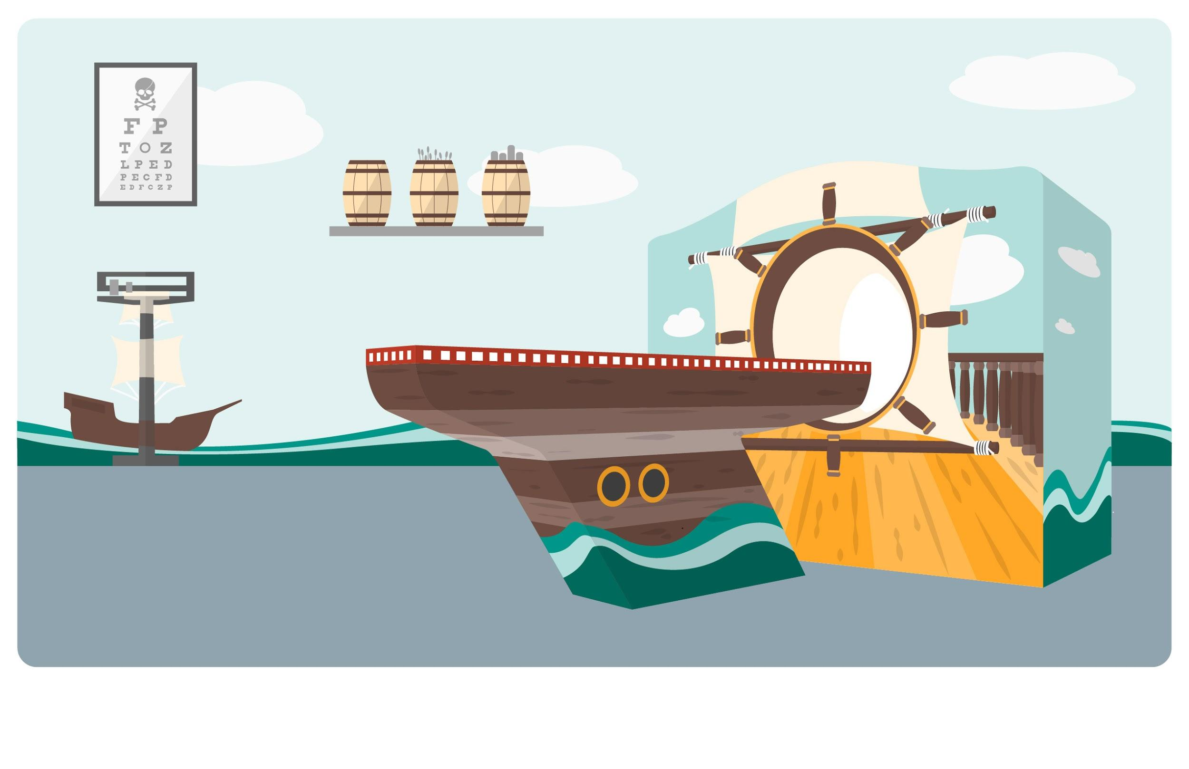
Inspiration
Notes:
The solution

Slide 19
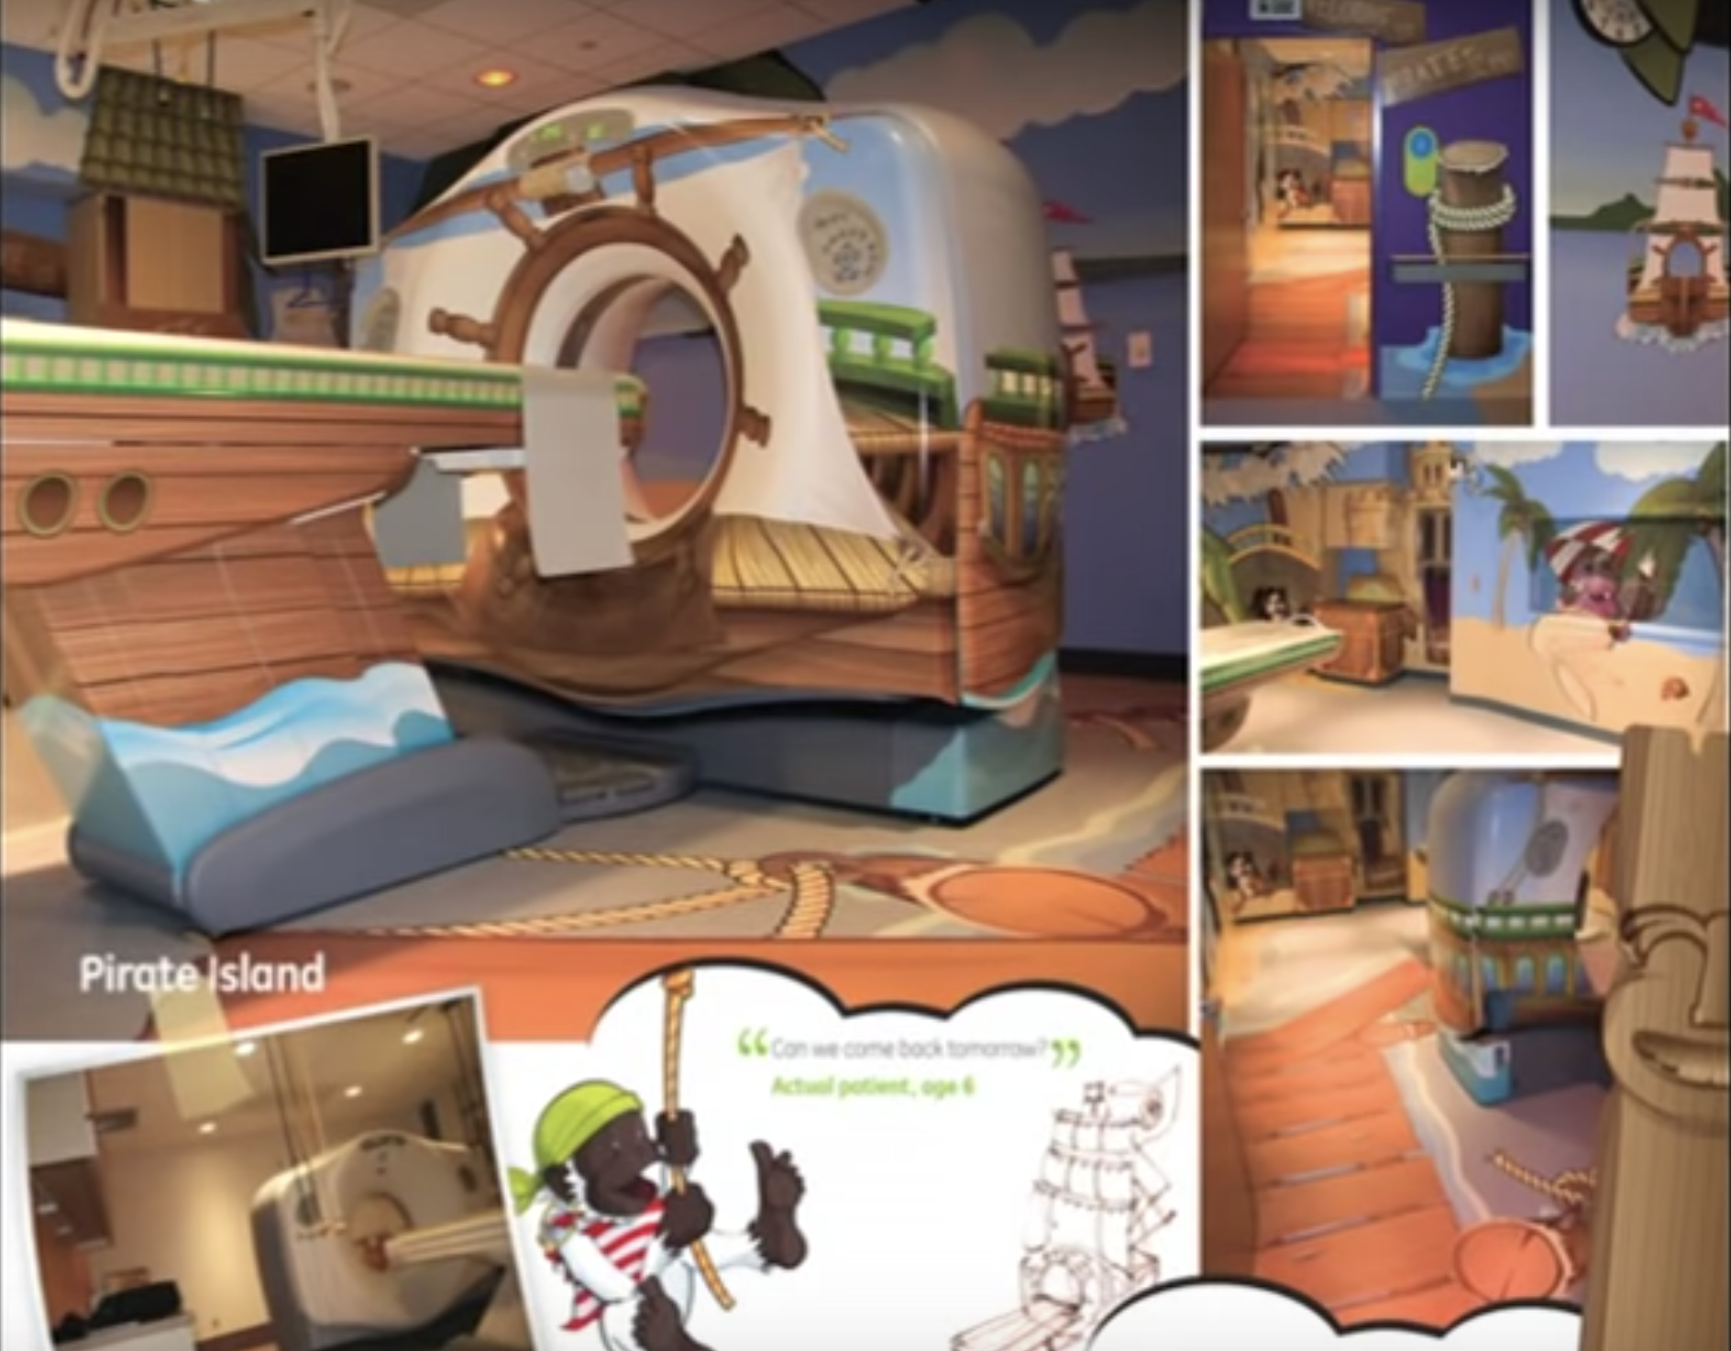
Notes:
The solution
This is the screenshots from DOUG DIETZ’s TEDx talk. The result? Phenomenal.
80% kids needed to be sedated before this solution was put in place, after this solution has been in place for 2 years? Only 2 kids needed to be sedated. 0.0 something %
[ 40 mins mark ]

Slide 20

5 mins break

Slide 21
Focus on the user
Empathy

Slide 22

Establishing Empathy
Your goal:
Connect to someone’s stories, insights, emotions.

Slide 23
Let’s do it!
Find partner, sit facing each other. Determine roles (Persons A & B).
Person A:
Speak for 3 minutes about a key personal moment from past year
If you run out of things to say, you can sit in silence
Person B:
Your job is to listen without speaking
If your mind wanders, bring it back and resume listening
(Later, we’ll ask you to reflect back what you hear)
Go!
Notes:
6 mins - 3 mins each

Slide 24
Reflect back
Person B:
Reflect back Person A’s key ideas and tone (don’t repeat every word)
Example:
What I heard you say is that you felt elated when you found out about your promotion...
Person A:
Offer feedback:
Did your partner capture the essence of what you shared?
What did your partner miss?

Slide 25

Switch Roles
Person B:
It’s your turn to speak about a key personal moment from the past year
Person A:
Listen without interrupting
Go!
Notes:
6 mins - 3 mins each

Slide 26
Reflect back
Person A:
Reflect back Person B’s key ideas and tone
Person B:
Offer feedback:
Did your partner capture the essence of what you shared?
What did your partner miss?
Notes:
6 mins - 3 mins each

Slide 27
Takeaways
Empathy requires you checking assumptions and ideas at the door
Feedback helps you hone in on speaker’s reality
Now let's apply these techniques to our project!
Notes:
[ 1hr 20mins mark ]

Slide 28
User Research
User Journeys
Polls & surveys
Website activity
Social media
Personas
Interviews
Observation
Immersion
Online forums
Notes:
What do all of these research types have in common? They look to understand user feelings, motivations, needs, etc.
Techniques we use include: Research current solutions, interview experts, questionnaires, search sites, observe users, collect sketches, photos, videos, and artifacts to analyze and synthesize users needs.

Slide 29

Interviews
Notes:
This is one of the ways that empathy shows up in d.thinking

Slide 30

Interviews
Uncover needs of your users through
stories, emotions, and insights
Your goal is not to think up new ideas or find solutions
This prevents you from seeing their reality
Listen and ask for feedback (ie don’t jump to conclusions)
Notes:
This is one of the ways that empathy shows up in d.thinking

Slide 31
Interviewer Tips
Seek stories
“Tell me about a time…”
Ask open-ended questions
“Walk me through…”
Encourage elaboration:
“Tell me more about”
“why, why, WHY?”
Notes:
add longer list of tips to the website?

Slide 32
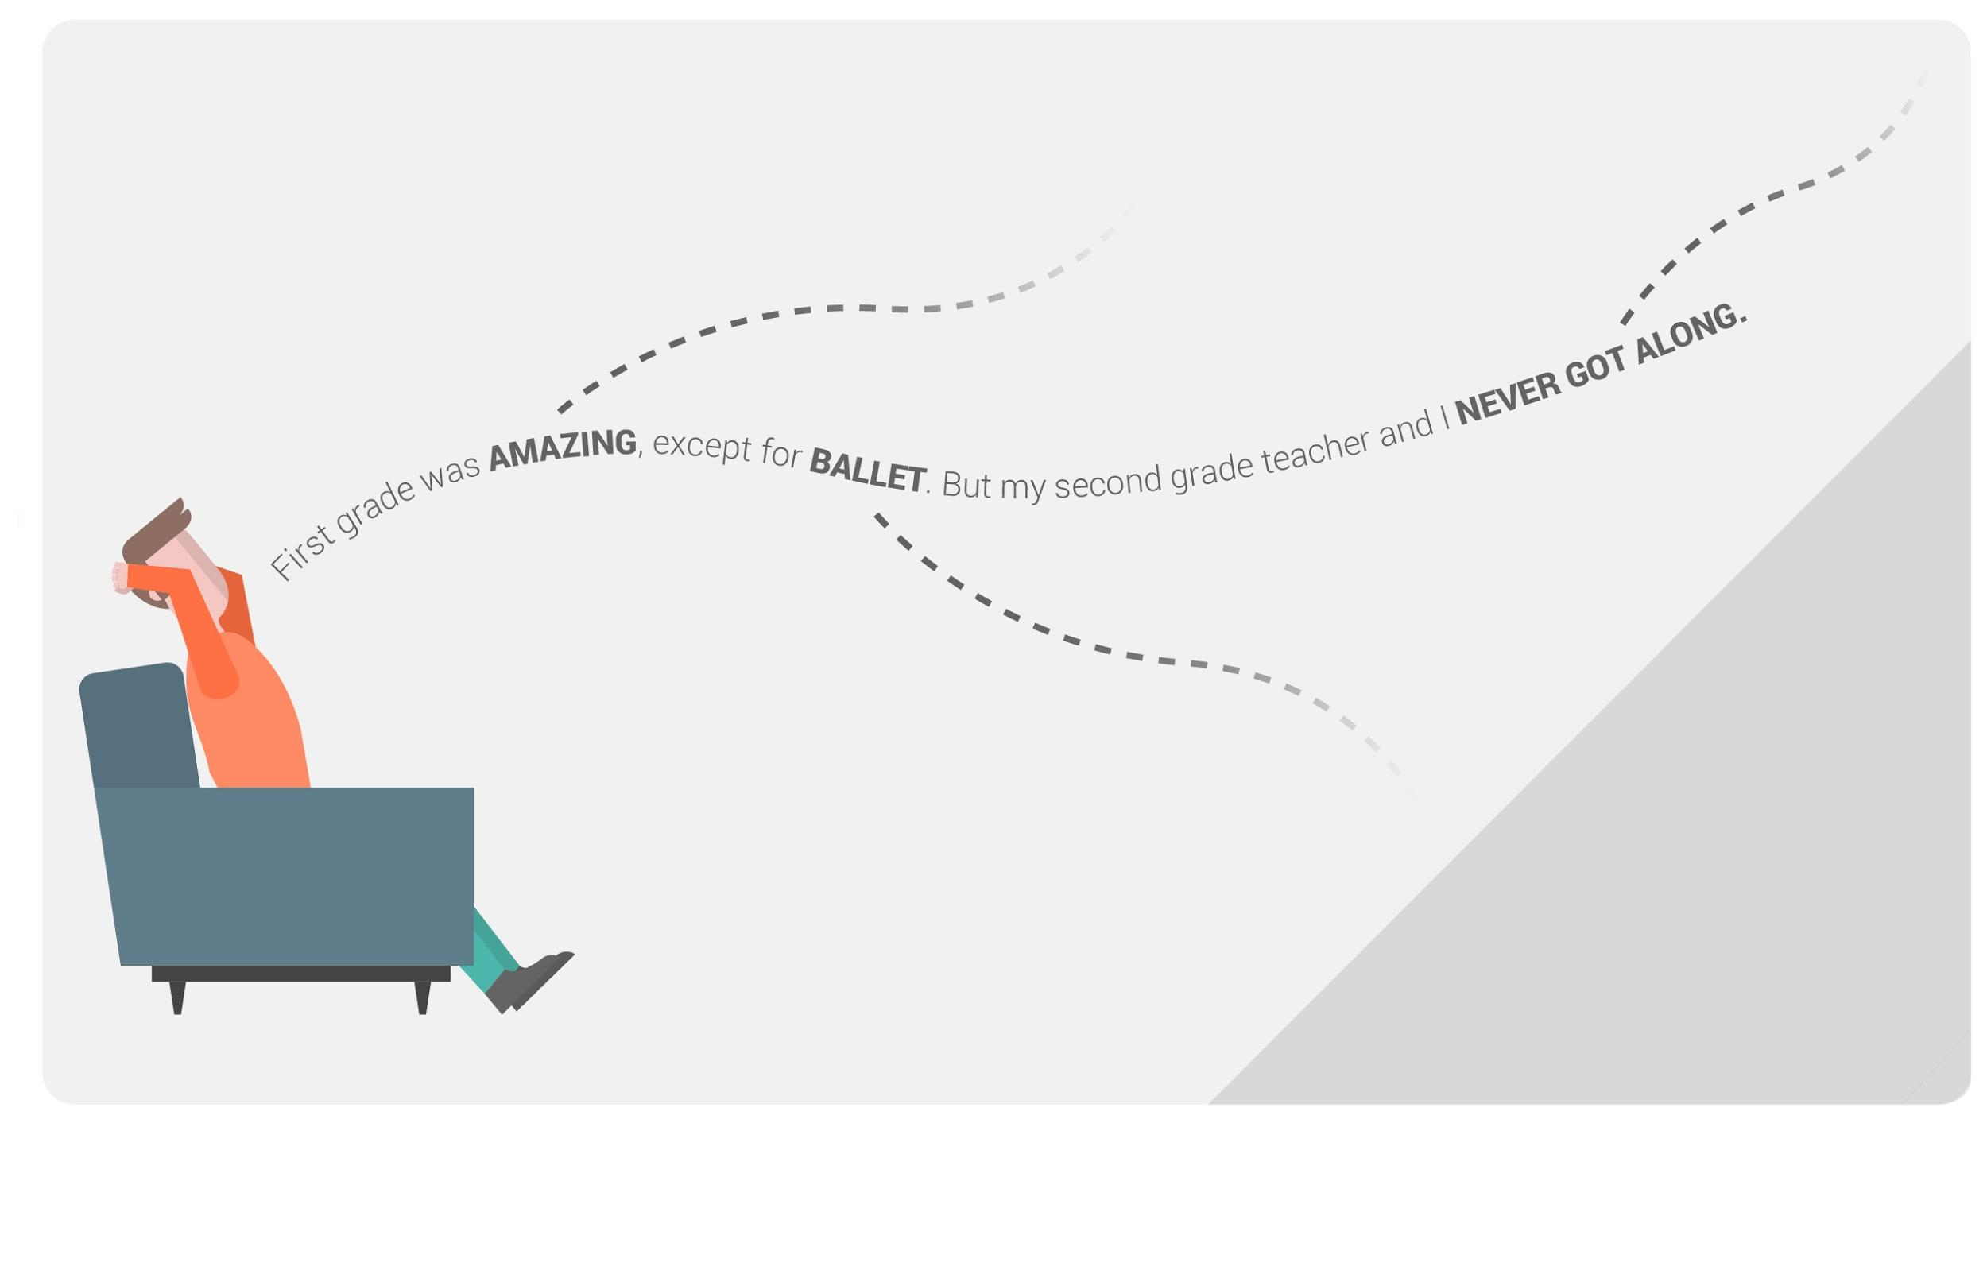
Encourage Elaboration
Notes:
[something like]
People often signal with their body, their tone, or their choice of words when there’s something beneath the surface of what they’re speaking. A good interviewer is constantly on the lookout for these signals. When he spots one, he’ll encourage the interviewee to elaborate. Sometimes, these elaborations won’t lead anywhere significant. Maybe the interviewee doesn’t remember why first grade was so amazing. But it’s often in probing that an interviewee gets to the meatiest content.

Slide 33
Sample Questions
QUESTIONS
/ Walk me through your last moving experience.
/ Tell me about the most positive job relocation you’ve ever had. What made it so positive?
/ If you had magic wand and could change one thing about the moving experience, what would you change?
AVOID (stay out of solution-land):
/ Do you think it’d be better if we had robot movers?
/ You mentioned worrying about your valuables getting stolen. What about hidden cameras?
Notes:
Ask the students to give more sample questions and we give feedback to their samples

Slide 34


Roles
Assign
Interviewer: 1 team member
Interviewee: 1 team member
Observers: remaining members of team
As Observers, your job is to:
Record missed opportunities for elaboration
Interesting insights

Slide 35
Question Prep
Interviewer and Observer:
Prepare some questions for your interview
(You will likely deviate from the list)
Interviewee:
Sit tight
10 mins
Notes:
[ 1hr 35mins mark ]

Slide 36
Interviewer Tips
Seek stories
“Tell me about a time…”
Ask open-ended questions
“Walk me through…”
Encourage elaboration:
“Tell me more about”
“why, why, WHY?”
Notes:
add longer list of tips to the website?

Slide 37
Interview Time
Go!
10 mins
Notes:
[ 1hr 50mins mark ]

Slide 38

Debrief
How did that go?
Observers:
Any opportunities for elaboration that were missed?
Did the interviewer stay out of solution-land?
Observers:
What’d you notice?
What interviewing tips were helpful?
5 mins
Notes:
[ 2hrs mark ]

Slide 39

Focus on the user
Definition
Notes:
[ 2hr mark ]

Slide 40
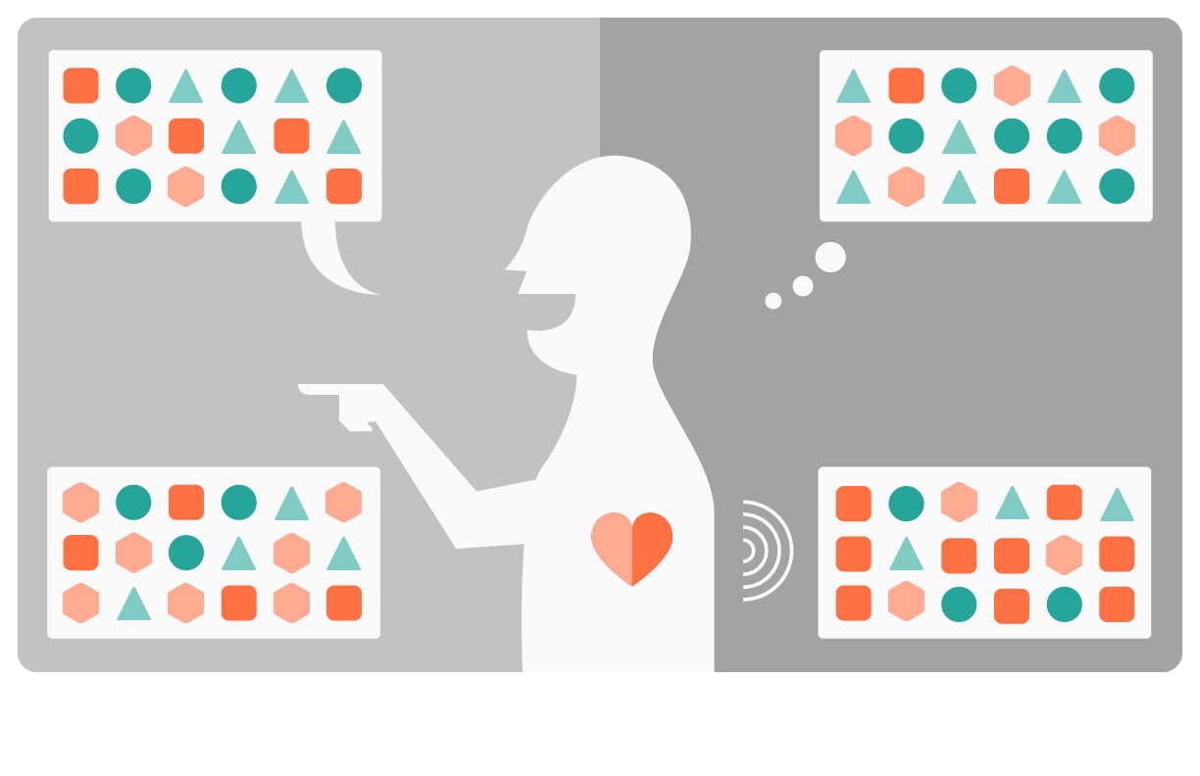




Slide 41

Facts
Objective
Inferences
Subjective
I heard...
Maybe this means...
5 mins
Notes:
Use 5 mins to work on the inferences based on the facts.
[ 2hr 15mins mark ]

Slide 42

Point of View
= User + need + insight
User = Be specific
Need = Use verbs
Insights = Observation + interpretation

Slide 43
Point of View
= User + need + insight
Great details!
Verbs - excellent!
“Jose is a busy manager who wants to eat healthier but doesn’t want to feel like he’s on a diet.”
Interesting insight!
User = Be specific
Need = Use verbs
Insights = Observation + interpretation

Slide 44
Point of View
= User + need + insight
This is a noun. Use verbs only.
“Jose needs more healthy menu options to have a better eating experience at Google.”
Who’s Jose?
Where’s the insight?
User = Be specific
Need = Use verbs
Insights = Observation + interpretation

Slide 45

Point of View = User + Need + Insight
is a
Name
user characteristics
who needs (a way to)
user’s need
because (they value)
Insight (Observation + interpretation)
Notes:
[ 2hr 30mins mark ]

Slide 46
Sally is a busy account manager who needs a way to help her merchants because she values in providing top quality eCommerce platform as a service that has low fraud cases.

Slide 47
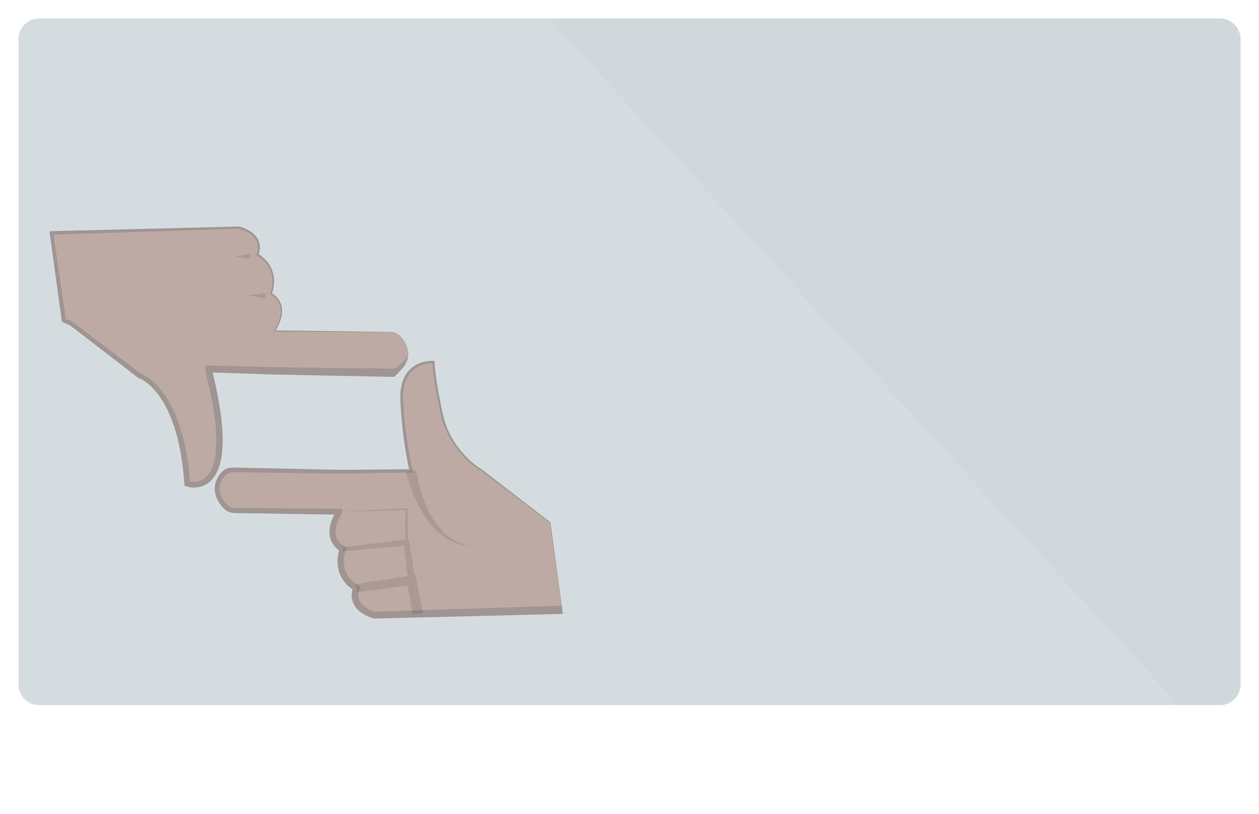
Framing a Problem
Describe goals,
not solutions

Slide 48

Framing a Problem
This is too narrow and focused on solution.
How might we create a ML model that predicts the probability of a customer being a fraud?
How might we identify fraud case more easily?
eek! Too general!

Slide 49

Framing a Problem
How might we [action] [what] for [whom] in order to [change something]?
How might we identify a pattern in purchase return activities for merchants who sell goods on our eCommerce platform in order to win their trust to list more products?

Slide 50
Framing a Problem
Use the POVs to generate 2-3 How Might We statements
(Describe goals, not solutions)
Notes:
Use the next 10 mins to generate 2-3 HMW statements. Write them on the sticky notes.
[ 2hr 45 mark ]

Slide 51
5 mins break

Slide 52

Think 10X

Slide 53

Think 10X
Brainstorm

Slide 54

“Yes, and” > “No, but”
Build on the
ideas of others.

Slide 55
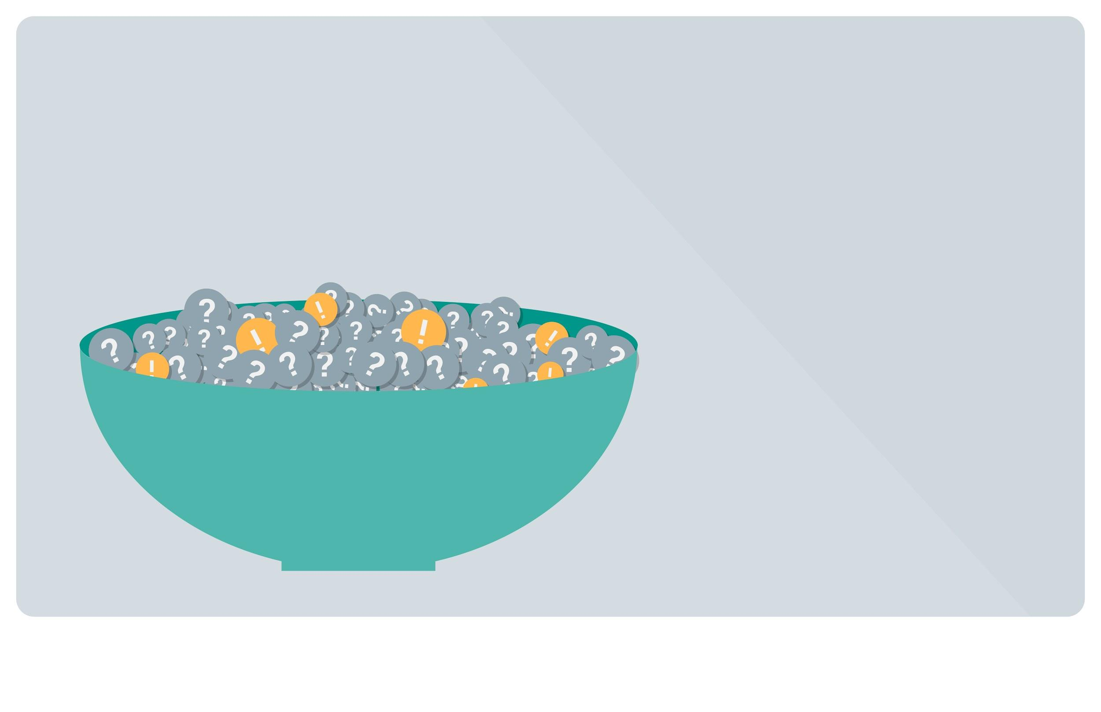
Quantity > Quality
The best way to have
a great idea is to have
lots of ideas.

Slide 56
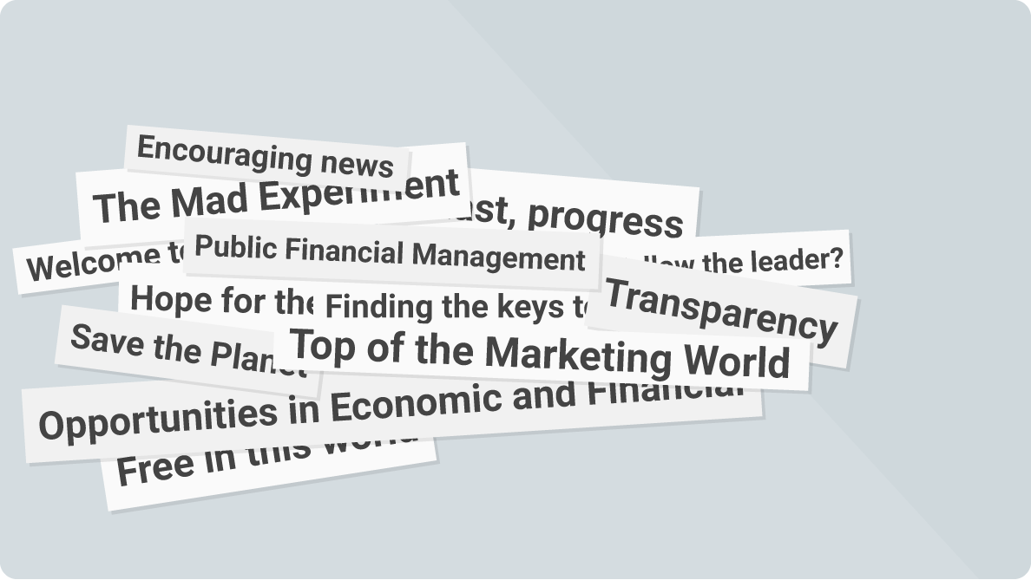
Write Headlines
< 6 words
No need to have
all the details yet

Slide 57
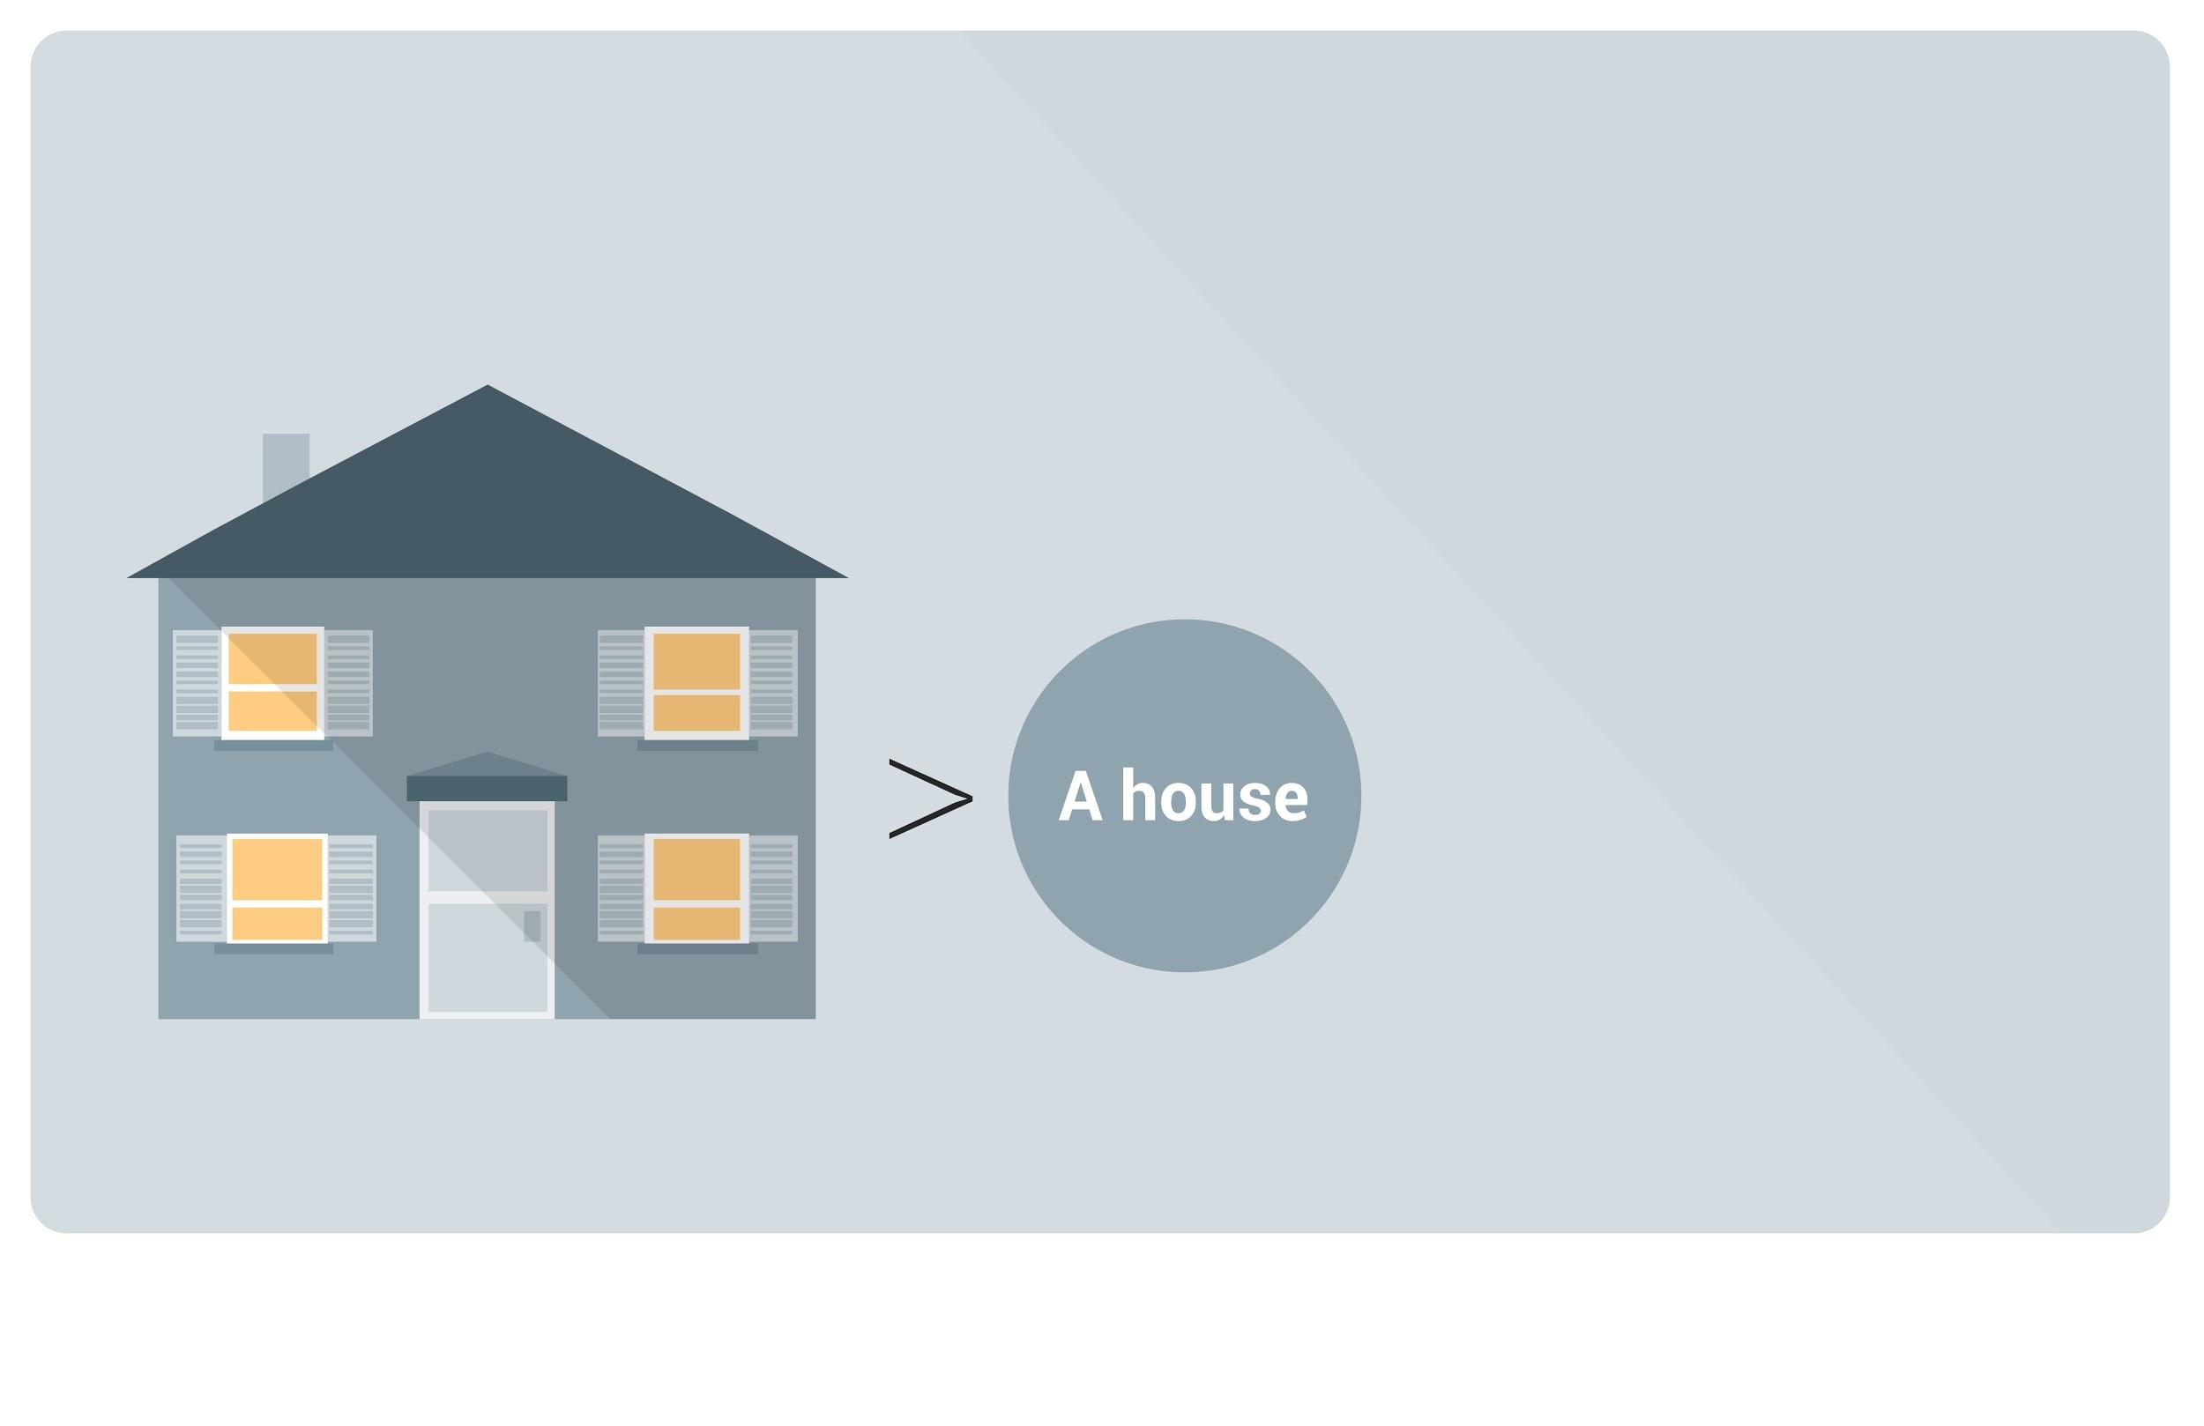
Visual > Text
Hard to miscommunicate with a picture.

Slide 58

Big ideas
Just beyond crazy…
is fabulous!

Slide 59

No Judgment
Judge all you want
afterwards.

Slide 60
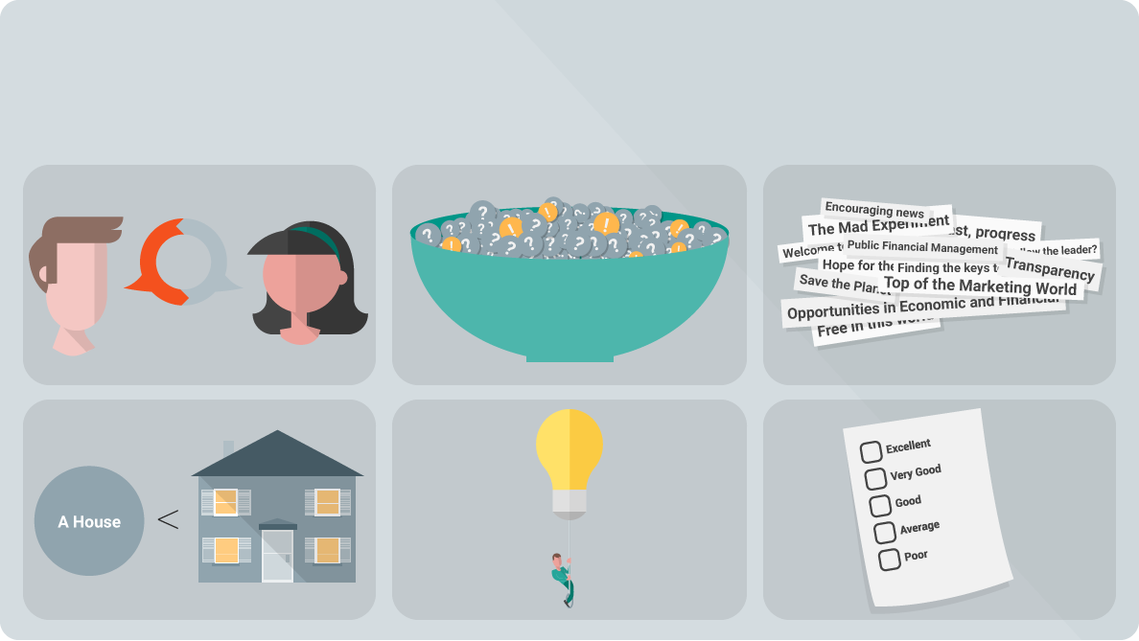
Brainstorm: Guidelines

Slide 61
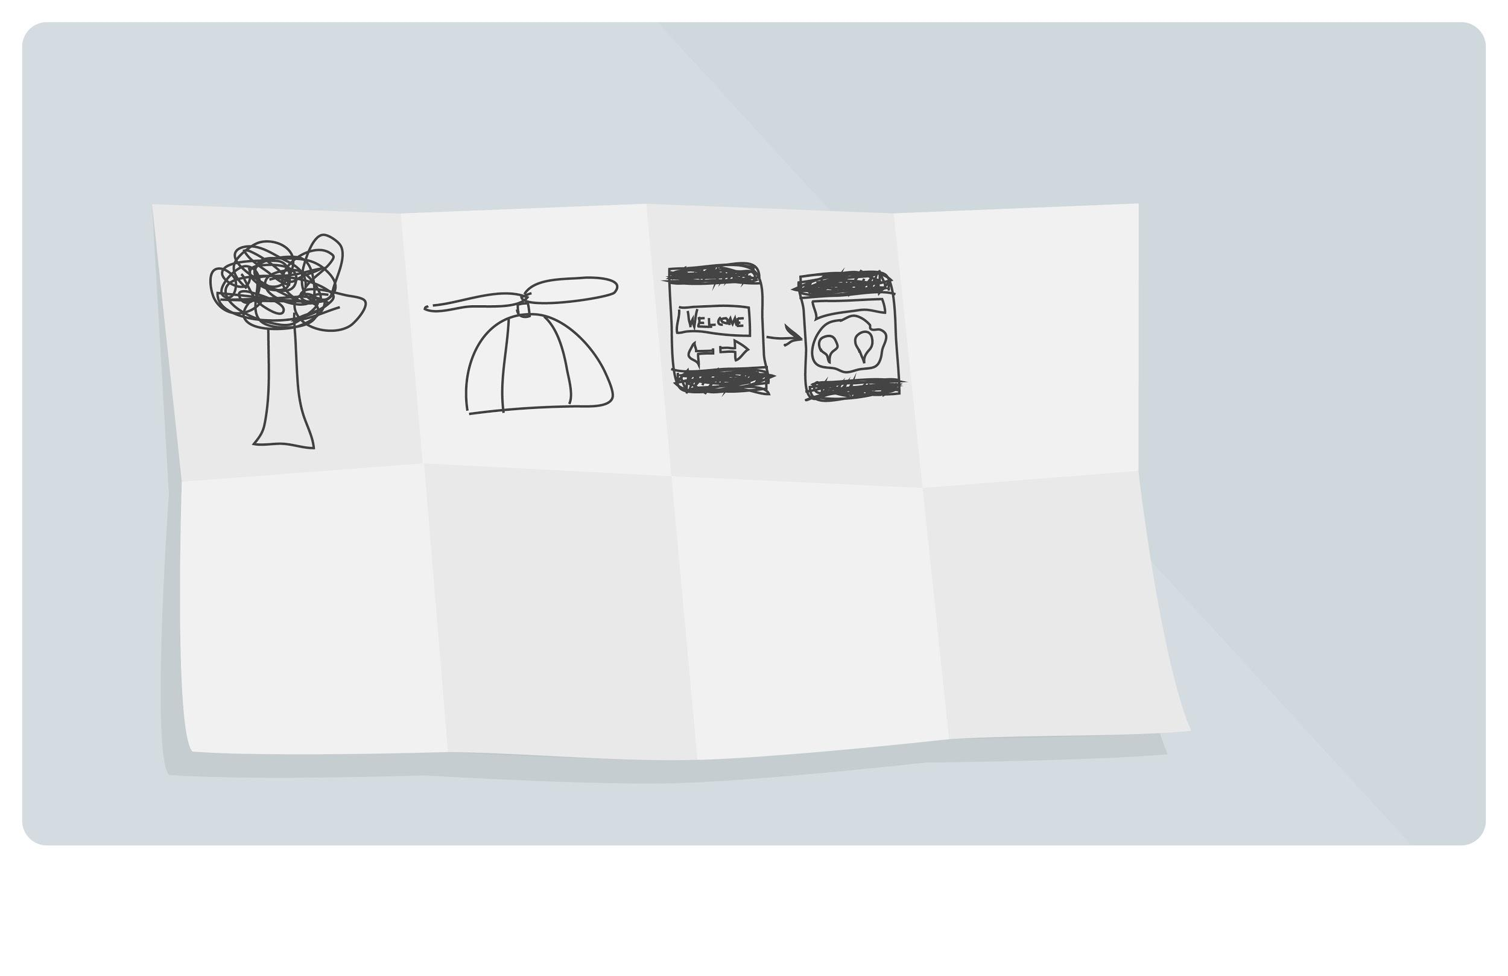
Individual Brainstorming
Notes:
15 mins
[ 3hr mark ]

Slide 62
Pitch & Vote
Notes:
10 mins

Slide 63
Individual Brainstorming
Notes:
15 mins

Slide 64
Pitch & Vote
Notes:
10 mins

Slide 65

Title
Presentation
Subtitle
Notes:
30 mins
[ 3hr 30mins mark ]

Slide 66
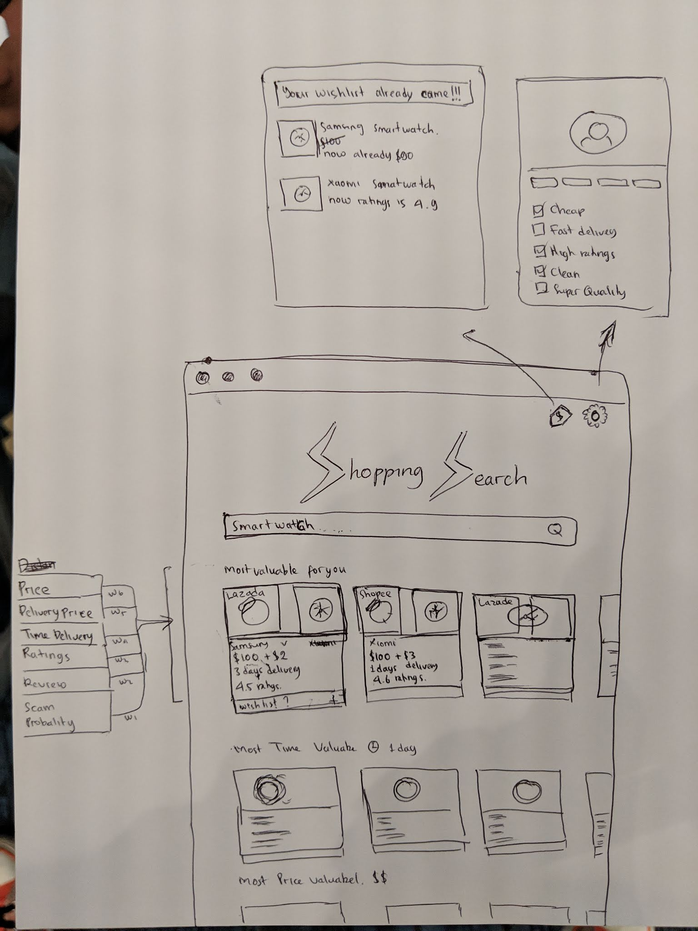

Slide 67
Design Thinking
ML Bootcamp edition

Slide 68

Would you like to
go beyond traditional brainstorming?
Wondering how to make brainstorming over VC more effective?
Need a creative jolt or new insights?
Find the right brainstorming techniques for you: go/brainstorm
Notes:
If we have time, we can do a big idea process to select one best idea per team and present. The best team will win some extra swags.
We can ask them to email their big idea with description of their ideas
To choose the winner, we do a vote between Googler
Annouce the winner at the end of summit

Slide 69
Stop here

Slide 70

Be prototype-driven

Slide 71

Think 10X
prototype
Be prototype driven
Notes:
Michal - part

Slide 72
Plan
Challenge: Your challenge is to find ways to encourage teenagers to be interested in STEM (Science, Technology, Engineering and Math).
160 students divide to 12 teams = 5 students / team
Invite other Googlers / GDGs / GBGs to co facilitate
Talk about all 5 steps.
Bok to lead phase 1 (slides 1-33)
Marcus to lead phase 2 (slides 34-46)
Yohan to lead phase 3 (slides 47-60)
Facilitator: Amu, Charlotte, Vaibhavi, Naveen, Jen, Alyssa, Laura, Ibnu, Dennis

Slide 73

What’s a prototype?
An early version of an idea built to:
out assumptions
answer questions

Slide 74
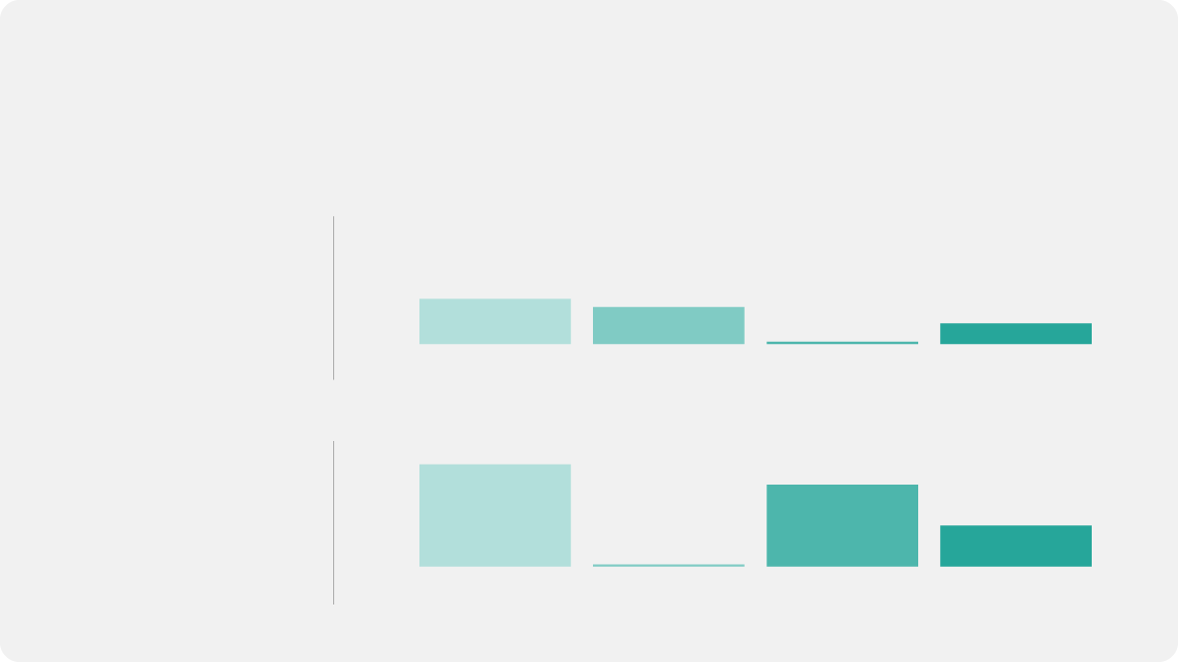
The prototyping effect
Without prototyping
IDEAS TRIED
SLOW FAILURES
FAST FAILURES
SUCCESSES
With prototyping
IDEAS TRIED
SLOW FAILURES
FAST FAILURES
SUCCESSES

Slide 75
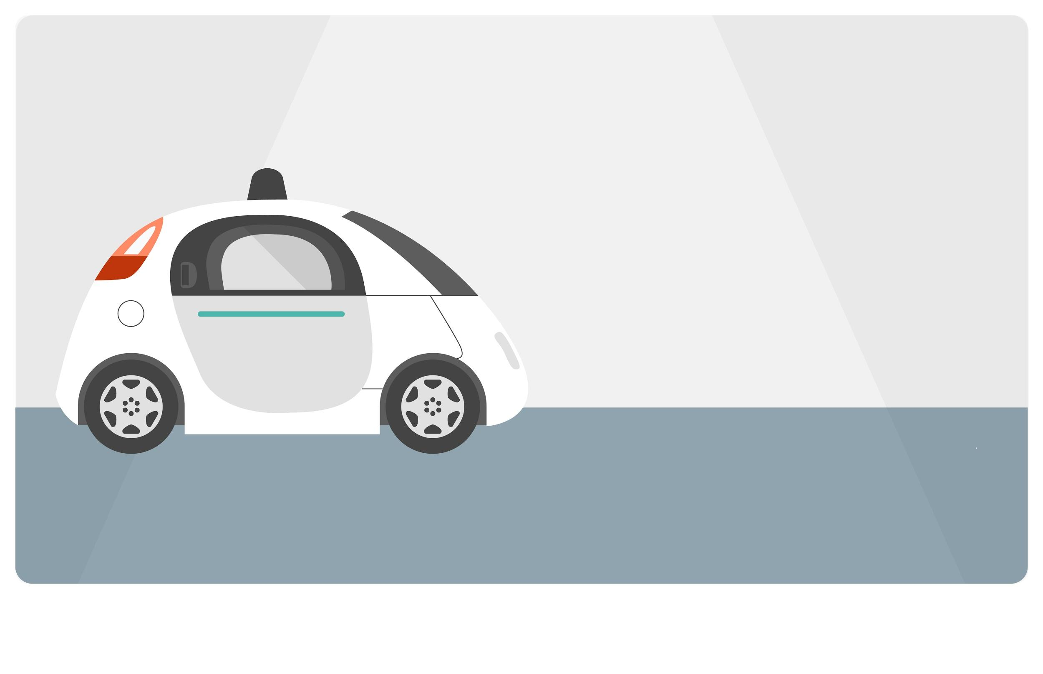
Outing assumptions
Assumption: People want driver-assisted vehicles
Notes:
https://www.youtube.com/watch?v=d5_h1VuwD6g

Slide 76

Questions prototypes ask
DO PEOPLE WANT IT?
HOW SHOULD IT WORK?
Would people use this thing?
Would people buy this thing?
Would people prefer this thing over that other thing?
Can people do this thing we want them to do?
How will this interaction feel?
Do people understand where to click?

Slide 77
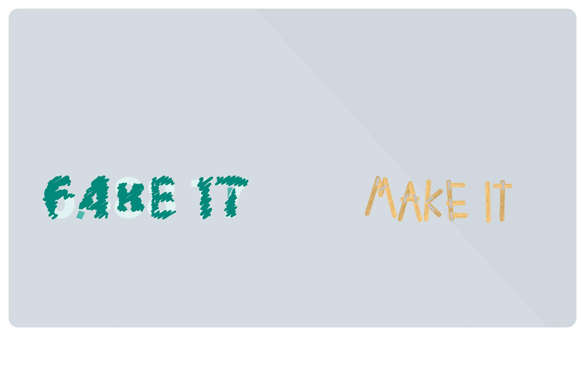
How to prototype
or
(small, quick, partially)

Slide 78

Suppose…
Notes:
Suppose you had the idea of creating a floating desk in the sky. You think it’s a good idea. You think people would like working there. But you can’t be sure.
Prototyping this idea would help you quickly validate whether people want a floating desk and how you should design it

Slide 79


Do people like working in high up places?

Slide 80

Do people like working in high up places?

Slide 81
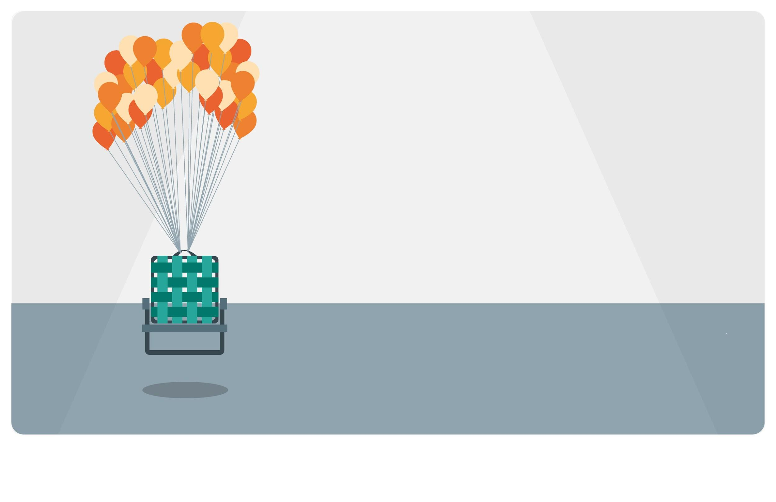

(small, quick, partially)
How much helium does it take to lift a person?
Notes:
you can prototype one thing various different ways to answer different questions
Also, a prototype can address several questions, but typically, it focuses on a few core questions.

Slide 82

Will people use a device that fits in a shirt pocket?

Slide 83
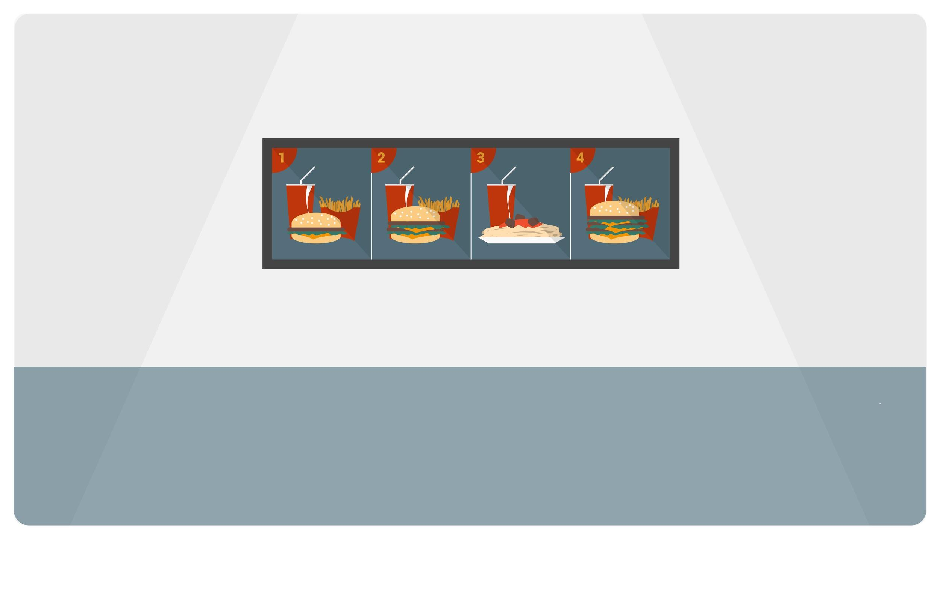
Will people order McSpaghetti?

Slide 84

(small, quick, partially)
Will people buy new electronics if we payed them for their old ones?

Slide 85
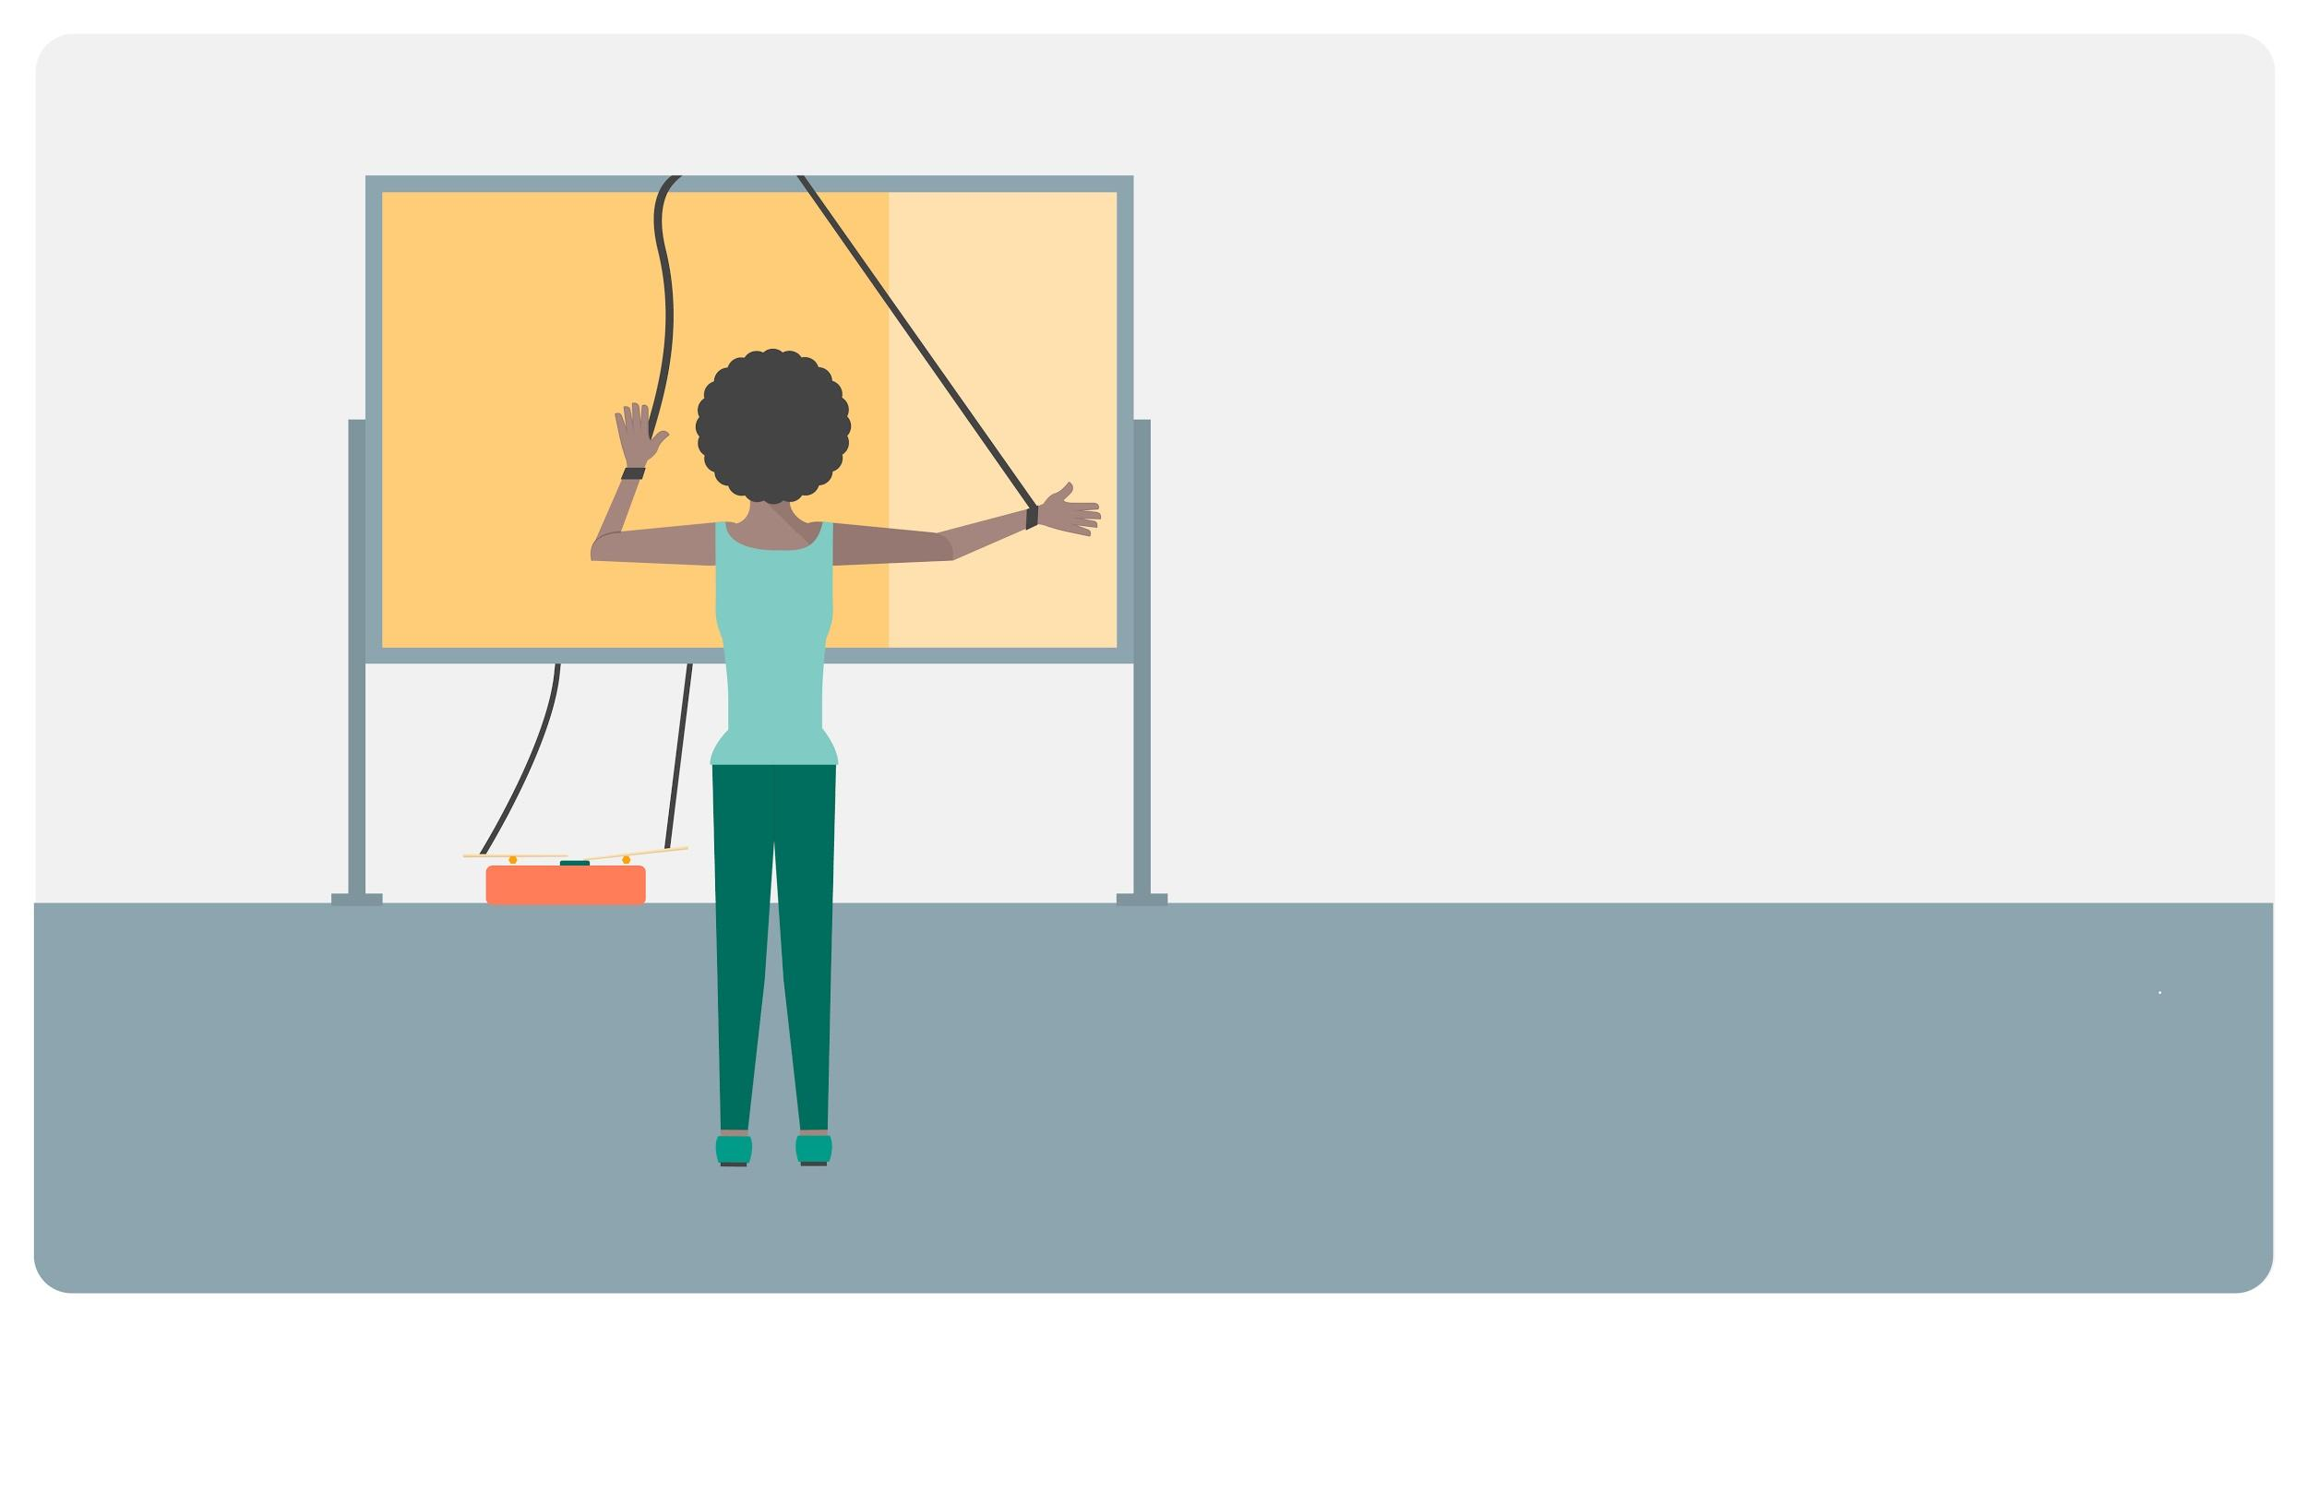
(small, quick, partially)
Will people use hand gestures to navigate software?

Slide 86
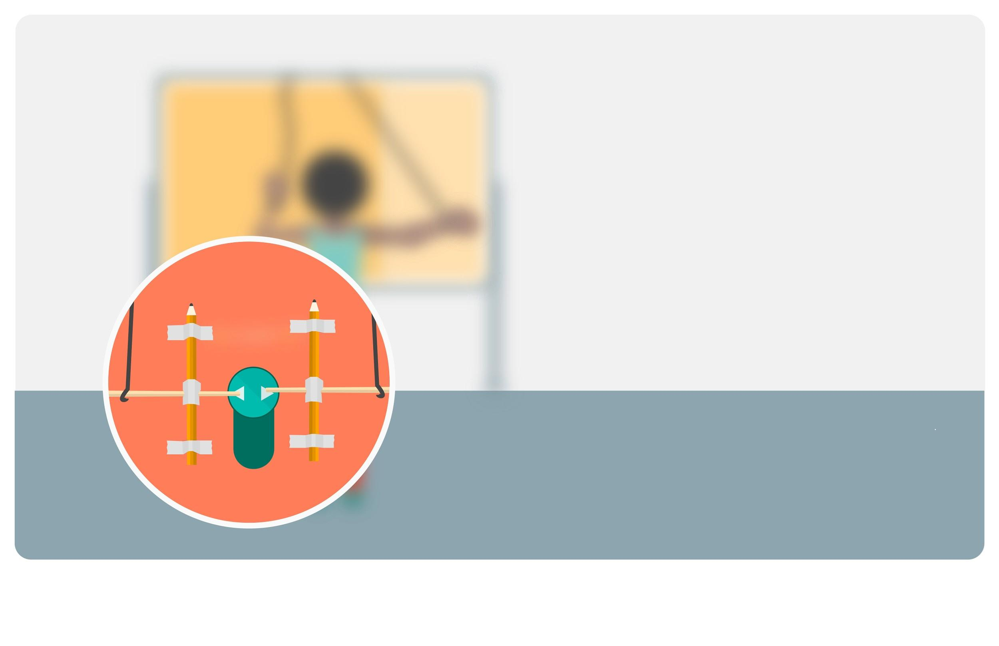
(small, quick, partially)
Will people use hand gestures to navigate software?

Slide 87

How would you prototype...
Job rotation program so people can learn about peers’ roles
Would people sign up for a rotational program?
New candidate to join team
How collaboratively would this person work on the team?
Food delivery app
How quickly do people need their food delivered?
Notes:
Activity in groups of 2 or 3

Slide 88

Your turn
What questions do you want to answer with your prototype?
Create a prototype that will help you answer a few of your core questions

Slide 89

test
Be prototype driven

Slide 90

Find your USER
and test your prototype.
TESTING = EMPATHY

Slide 91
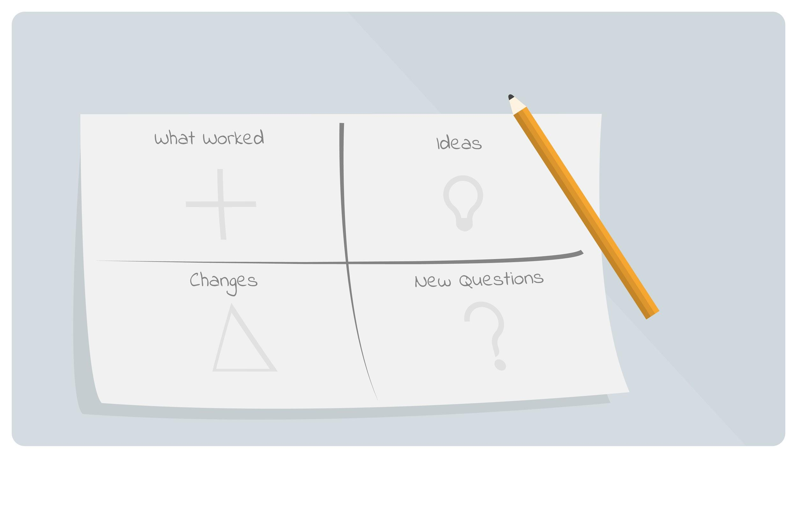
Track the feedback
Track the feedback
That you are receiving
from your users.
Pain Points
What didn’t they like?
Bright Spots
What did they like?
Answers
What did you learn about your questions?

Slide 92
Focus on the user
Think 10X
empathy
definition
brainstorm
prototype
test
Be prototype driven

Slide 93

Focus on human values

Slide 94

Bias Towards Action

Slide 95

Change
Your Perspective.

Slide 96

Get Experimental
And Experiential.

Slide 97

Be Mindful
Of Process.

Slide 98

Show,
Don’t tell.

Slide 99

Collaborate
Across boundaries.

Slide 100
I liked...
I wish...
empathy
definition
brainstorm
prototype
test
What if...?

Slide 101

WHAT
Network of Googlers who teach courses,
mentor 1:1, or design learning programs
WHO
Any Googler who contributes to learning by spending time outside their core role
HOW
Check out go/LearntoTeach and go/g2g
Googlers to Googlers
teach • share • learn
Notes:
Speaking points below: This course is brought to you by g2g!
What:
The g2g program enables Googlers to teach, share, and learn from each other. Most Grow courses you take are facilitated by g2g’ers. In fact, nearly 85% of all formal learning at Google happens through the g2g program!
Who:
A g2g’er is any Googler outside of PeopleDev who contributes to the learning of Googlers on a volunteer basis. This could be through facilitating courses, mentoring, or designing learning programs.
Why:
Facilitators: Please include why you personally became involved with g2g!
How:
Get started teaching popular courses at go/LearntoTeach
If you already facilitate a course, make sure it is uploaded in Grow so you can get credit for your work and make the course easily accessible to other Googlers.
Please follow us on G+ (go/g2g+) and stay up to date on everything g2g! You can get information on new courses and facilitation opportunities.
Head to go/g2g for more info, to start teaching PeopleDev courses or to go/TYOS to design your own content and “teach your own stuff”!

Slide 102

go/innovation-learning
go/innovationguru
Follow us on G+
go/iamhere
go/Grow Your Way and find...
Learning resources
Job opportunities
Personalized recommendations
Want to get involved and share your expertise? go/g2g

Slide 103
Appendix

Slide 104
where do you have your best #IDEAS?
Notes:
Mikkel

Slide 105
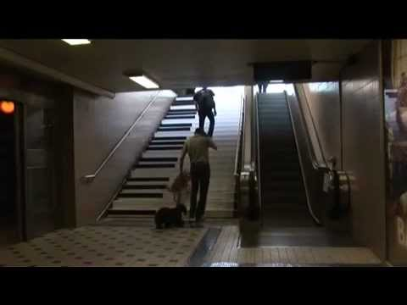
Inspiration
How might we...get more people to choose the stairs by making it fun to do?
Notes:
https://www.youtube.com/watch?v=bRCW8W_jPIM
1:47
Also good inspiration:
http://news.distractify.com/fun/illustrator-draws-faces-lets-4-year-old-draw-bodies-ends-up-with-adorably-weird-art/?v=1

Slide 106
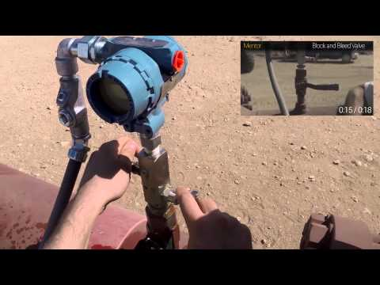
Inspiration
In the field, Wearable Intelligence provides operators and engineers with an enterprise-grade, secure, hands-free wearable platform to improve day-to-day workflow, safety, and compliance.
Notes:
Glass Explorer program an example of this.
Wearable Intelligence are a certified Glassware partner in the US and have produced a bespoke app to help with operations, workflow and safety. Although not completely relevant has some cross over.
Video link:
http://youtu.be/lkH88TTgt6A (3:27)

Slide 107
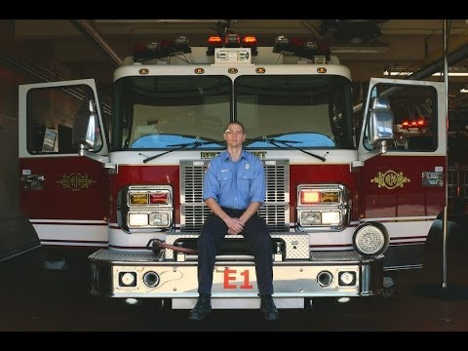
Information they need, when they need it
Notes:
Glass firefighter: http://youtu.be/QPbZy2wrTGk (1:28)
Glass - how it feels: http://youtu.be/v1uyQZNg2vE (2:15)
Glass physics teacher - Explorer program: http://youtu.be/yRrdeFh5-io (2:14)
Glass London: https://www.youtube.com/watch?v=Z3AIdnzZUsE (1:01)
Agnes: https://www.youtube.com/watch?v=3Q53ys8Yw9w
(3:30)
Other video:
https://www.youtube.com/watch?v=czuww9rp5f4
1:12

Slide 108

Create a Game
Create a board game themed around the Mediterranean
18 minutes
Make sure users can play it (we will test it!)
Create 15 sec presentation / marketing video
Mediterranean themed
Create 15-sec pitch
Notes:
Warmup activity
Create a boardgame, in groups of 5-6
Make sure users can play it --> we will test it - ie. two groups swap and test one anothers’ games. Need to ensure two members of a team stays back to play/explain the game to the testers.
(one added option: Create a 15 sec marketing video.)
25mins
Winning team receives: XXX

Slide 109
Facts
Objective
Inferences
Subjective
What were they thinking?
How were they feeling?
What were they thinking?
How were they feeling?
What did they SAY?
What were they THINKING?
What did they say?
What were they doing?
What did they say?
What were they doing?
What did they DO?
How were they FEELING?

Slide 110
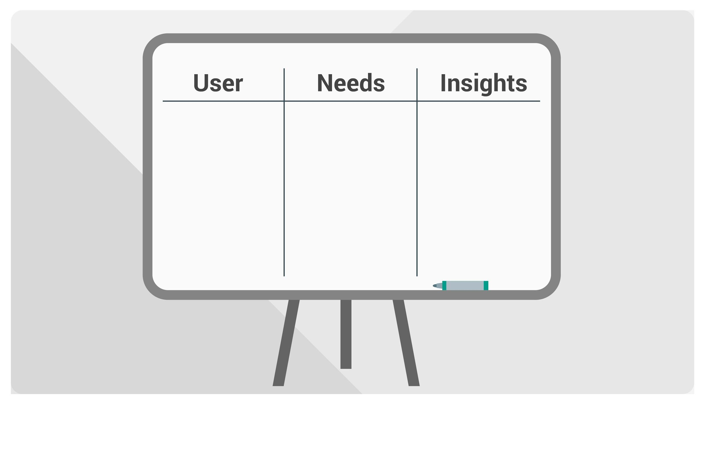
Doesn’t like the feeling of being on a diet
Busy
Eat healthy
Marketing manager
Have more energy for kids
Eating with others is how he connects
Dad of 2
Notes:
One way to create an empathy map is to generate a User, Needs, Insights chart. This chart allows you to develop a deeper understanding of your users, in turn helping you to create an actionable point of view statement (POV) that works as the foundation for your brainstorming.
In your groups, take 10 minutes to generate a chart that allows you to synthesize your findings from our Empathy stage.
Under User, list attributes of your user that seem relevant, such as "busy," "software engineer," "avid reader," etc.
Under Needs, list the users' needs you heard or inferred, such as "better metrics," "having more energy," “easier ways to manage weight loss,” etc.
Under Insights, list some of the things you heard and inferred from observing/understanding the user during the interview (trying to infer the true reasons / drivers for their needs).
Get on your feet; crowd around the whiteboard; and complete the map as a team!
Note: You can use this version of empathy mapping, or you can use the “Facts & Inferences” chart found in the appendix.

Slide 111

5 Thinking Hats
Optimist
Idea Generator
True Pessimist
Technical feasibility
User Advocate

Slide 112

Solve for <x>
Notes:
https://www.youtube.com/watch?v=0uaquGZKx_0#t=15

Slide 113
Selection of Master slides

Slide 114
Title
Subtitle

Slide 115
Title
Subtitle

Slide 116

Title
Subtitle

Slide 117
Title
Subtitle

Slide 118







Slide 119
Sample Title
Body text goes here.
Pellentesque sit amet auctor leo, quis condimentum felis. Cras pretium, lacus porttitor pretium eleifend, ipsum tellus rutrum felis, id pharetra ipsum sapien et metus.
Cras porta laoreet egestas.
Sed malesuada erat urna, eu fringilla odio scelerisque at.
In lacinia, libero sit amet ullamcorper consequat, turpis est dignissim magna, a mollis lectus risus nec ex.
Suspendisse vel elementum nulla. Fusce eget efficitur augue, et tincidunt urna. Quisque interdum tortor a rutrum molestie.

Slide 120

Sample Title
Body text goes here.
Pellentesque sit amet auctor leo, quis condimentum felis. Cras pretium, lacus porttitor pretium eleifend, ipsum tellus rutrum felis, id pharetra ipsum sapien et metus.
Cras porta laoreet egestas.
Sed malesuada erat urna, eu fringilla odio scelerisque at.
In lacinia, libero sit amet ullamcorper consequat, turpis est dignissim magna, a mollis lectus risus nec ex.
Suspendisse vel elementum nulla. Fusce eget efficitur augue, et tincidunt urna. Quisque interdum tortor a rutrum molestie.

Slide 121
Sample Title
Body text goes here.
Pellentesque sit amet auctor leo, quis condimentum felis. Cras pretium, lacus porttitor pretium eleifend, ipsum tellus rutrum felis, id pharetra ipsum sapien et metus.
Cras porta laoreet egestas.
Sed malesuada erat urna, eu fringilla odio scelerisque at.
In lacinia, libero sit amet ullamcorper consequat, turpis est dignissim magna, a mollis lectus risus nec ex.
Suspendisse vel elementum nulla. Fusce eget efficitur augue, et tincidunt urna. Quisque interdum tortor a rutrum molestie.

Slide 122

Sample Title
Body text goes here.
Pellentesque sit amet auctor leo, quis condimentum felis. Cras pretium, lacus porttitor pretium eleifend, ipsum tellus rutrum felis, id pharetra ipsum sapien et metus.
Cras porta laoreet egestas.
Sed malesuada erat urna, eu fringilla odio scelerisque at.
In lacinia, libero sit amet ullamcorper consequat, turpis est dignissim magna, a mollis lectus risus nec ex.
Suspendisse vel elementum nulla. Fusce eget efficitur augue, et tincidunt urna. Quisque interdum tortor a rutrum molestie.

Slide 123
Sample Title
Body text goes here.
Pellentesque sit amet auctor leo, quis condimentum felis. Cras pretium, lacus porttitor pretium eleifend, ipsum tellus rutrum felis, id pharetra ipsum sapien et metus.
Cras porta laoreet egestas.
Sed malesuada erat urna, eu fringilla odio scelerisque at.
In lacinia, libero sit amet ullamcorper consequat, turpis est dignissim magna, a mollis lectus risus nec ex.
Suspendisse vel elementum nulla. Fusce eget efficitur augue, et tincidunt urna. Quisque interdum tortor a rutrum molestie.

Slide 124
Sample Title
Body text goes here.
Pellentesque sit amet auctor leo, quis condimentum felis. Cras pretium, lacus porttitor pretium eleifend, ipsum tellus rutrum felis, id pharetra ipsum sapien et metus.
Cras porta laoreet egestas.
Sed malesuada erat urna, eu fringilla odio scelerisque at.
In lacinia, libero sit amet ullamcorper consequat, turpis est dignissim magna, a mollis lectus risus nec ex.
Suspendisse vel elementum nulla. Fusce eget efficitur augue, et tincidunt urna. Quisque interdum tortor a rutrum molestie.

Slide 125
Sample Title
Body text goes here.
Pellentesque sit amet auctor leo, quis condimentum felis.
Cras porta laoreet egestas.
Sed malesuada erat urna, eu fringilla odio scelerisque at.
In lacinia, libero sit amet ullamcorper consequat, turpis est dignissim magna, a mollis lectus risus nec ex.

Slide 126
Sample Title
Body text goes here.
Pellentesque sit amet auctor leo, quis condimentum felis. Cras pretium, lacus porttitor pretium eleifend, ipsum tellus rutrum felis, id pharetra ipsum sapien et metus.
Cras porta laoreet egestas.
Sed malesuada erat urna, eu fringilla odio scelerisque at.
In lacinia, a mollis lectus risus nec ex.

Slide 127
Sample Title
Body text goes here.
Pellentesque sit amet auctor leo, quis condimentum felis. Cras pretium, lacus porttitor pretium eleifend, ipsum tellus rutrum felis, id pharetra ipsum sapien et metus.
Cras porta laoreet egestas.
Sed malesuada erat urna, eu fringilla odio scelerisque at.
In lacinia, libero sit amet ullamcorper consequat, turpis est dignissim magna, a mollis lectus risus nec ex.

Slide 128
test
Be prototype driven

Slide 129
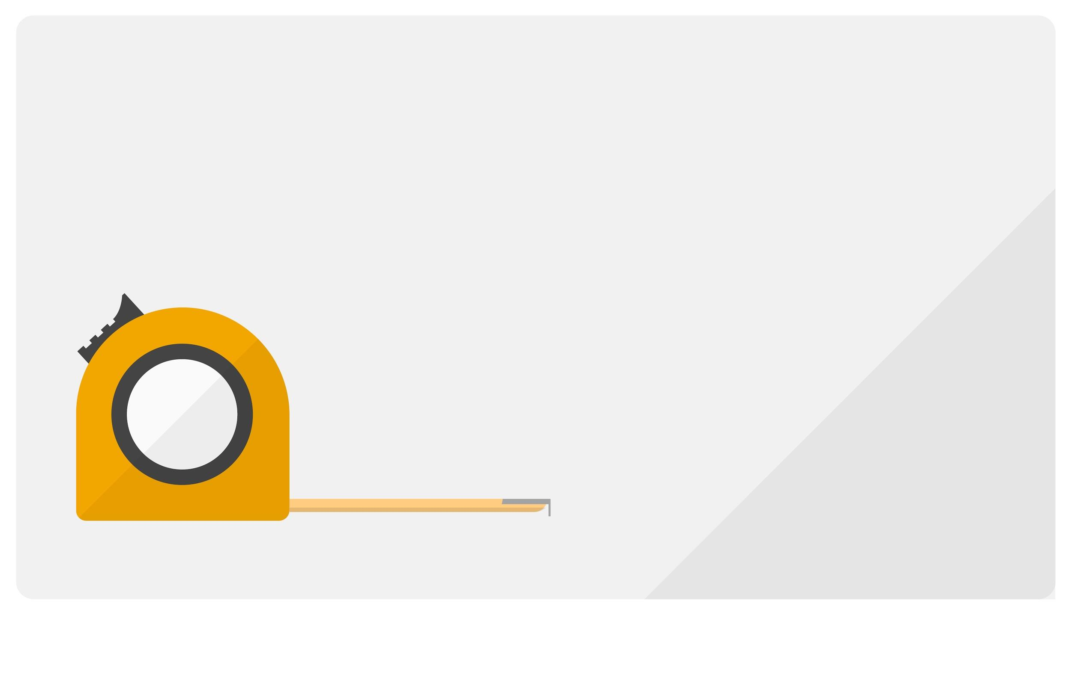
Measuring success
How will you know if your prototype is successful?
Determine your metrics before you test

Slide 130
QUESTION:
Will people use a device that fits in a shirt pocket?
SUCCESS:
After 2 weeks,
users pull it out 3 times daily

Slide 131
QUESTION: Will people order McSpaghetti?
SUCCESS:
Moderate: 50-100 orders
Wild: 100+ orders

Slide 132
Measuring success
Create metrics for your prototype

Slide 133
Find your USER
and test your prototype.
TESTING = EMPATHY

Slide 134
Track the feedback
Track the feedback
That you are receiving
from your users.
Pain Points
What didn’t they like?
Bright Spots
What did they like?
Answers
What did you learn about your questions?

